Slide 1
Case Example:
Investigation of a head injury 25 years prior
Baseline
Challenge Medication

Slide 2
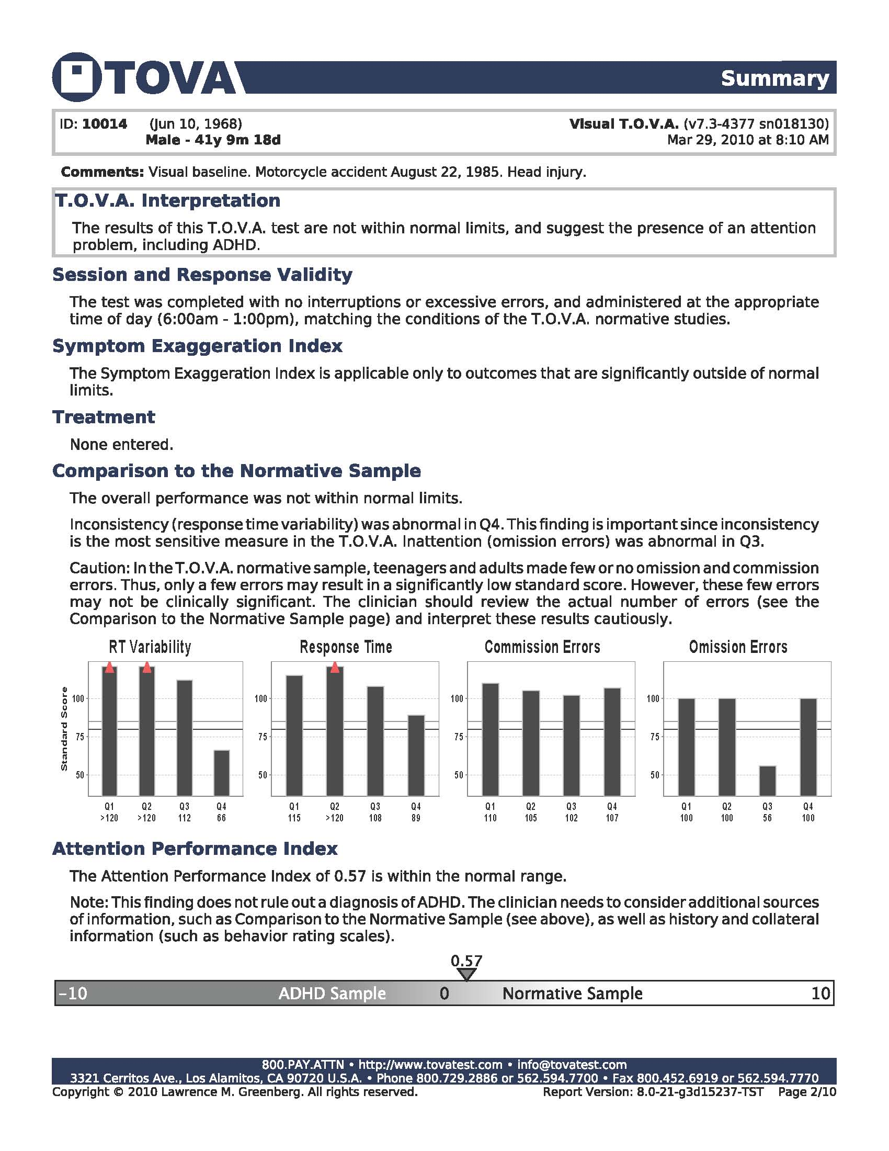

Slide 3
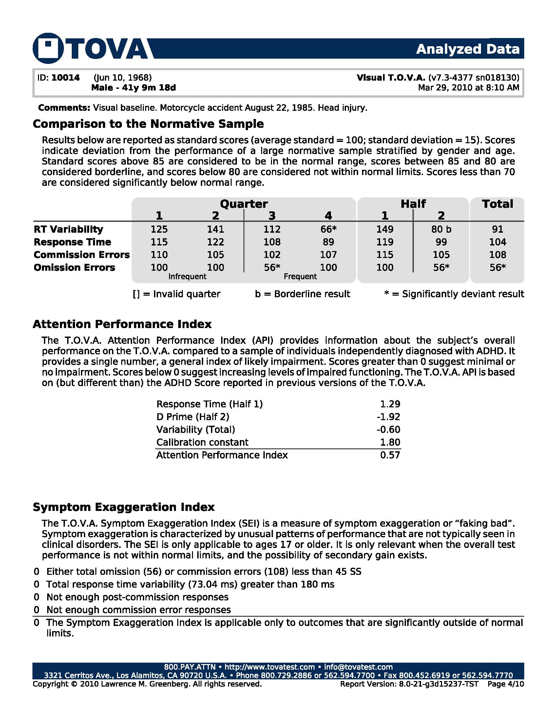

Slide 5
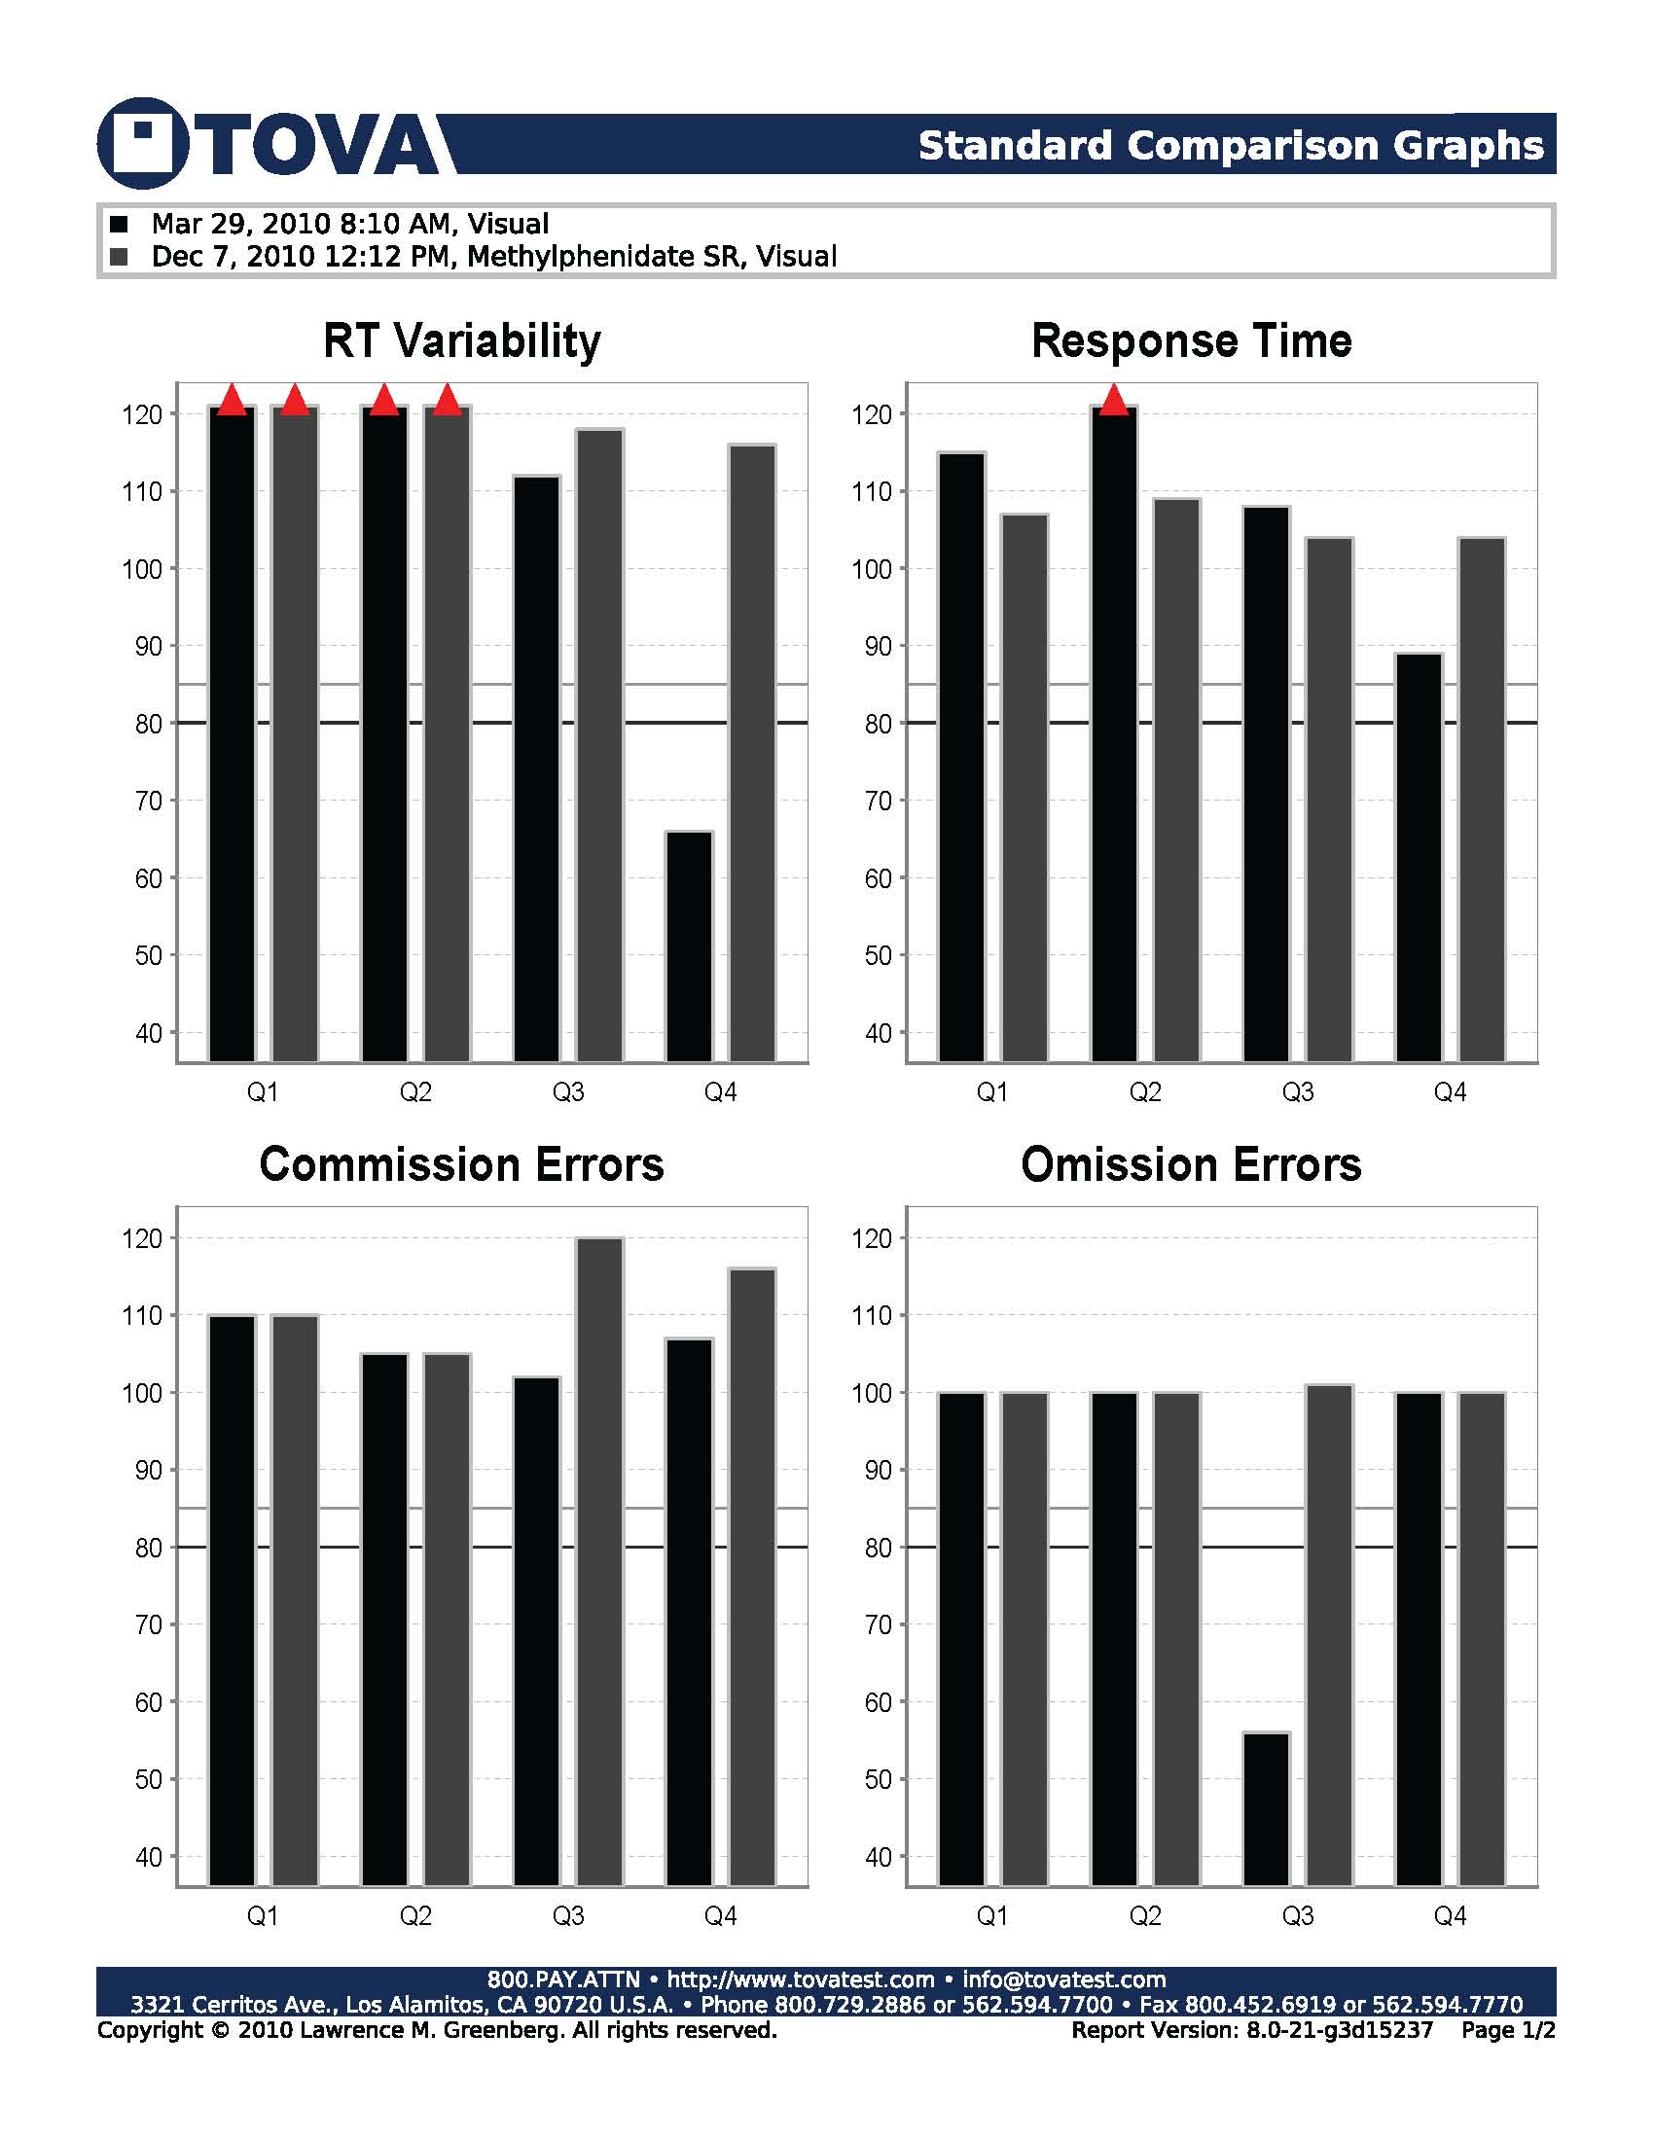

Slide 6
Case Example:
Investigation of reported “inconsistency”
Baseline with SEI
Challenge Medication #1 – Mixed
Challenge Mediation #2 - Best

Slide 7
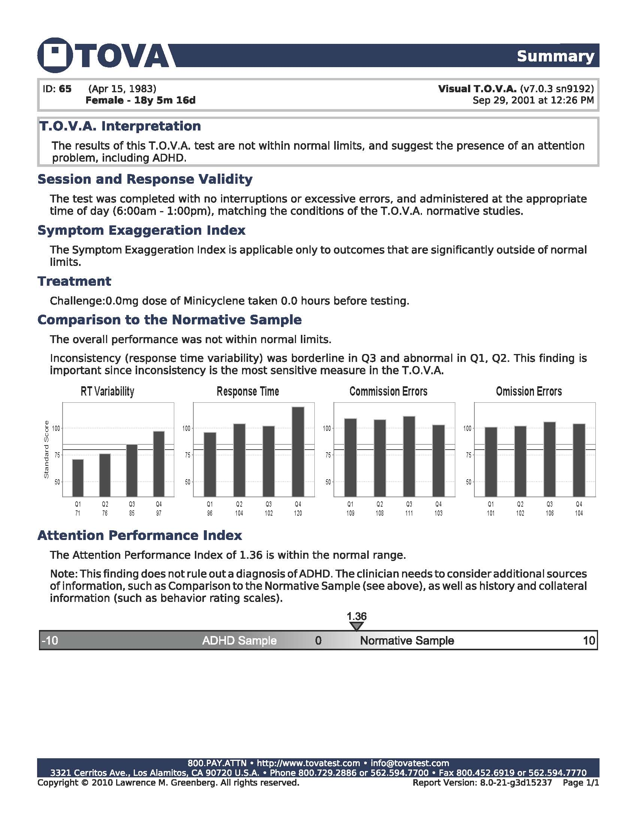

Slide 8
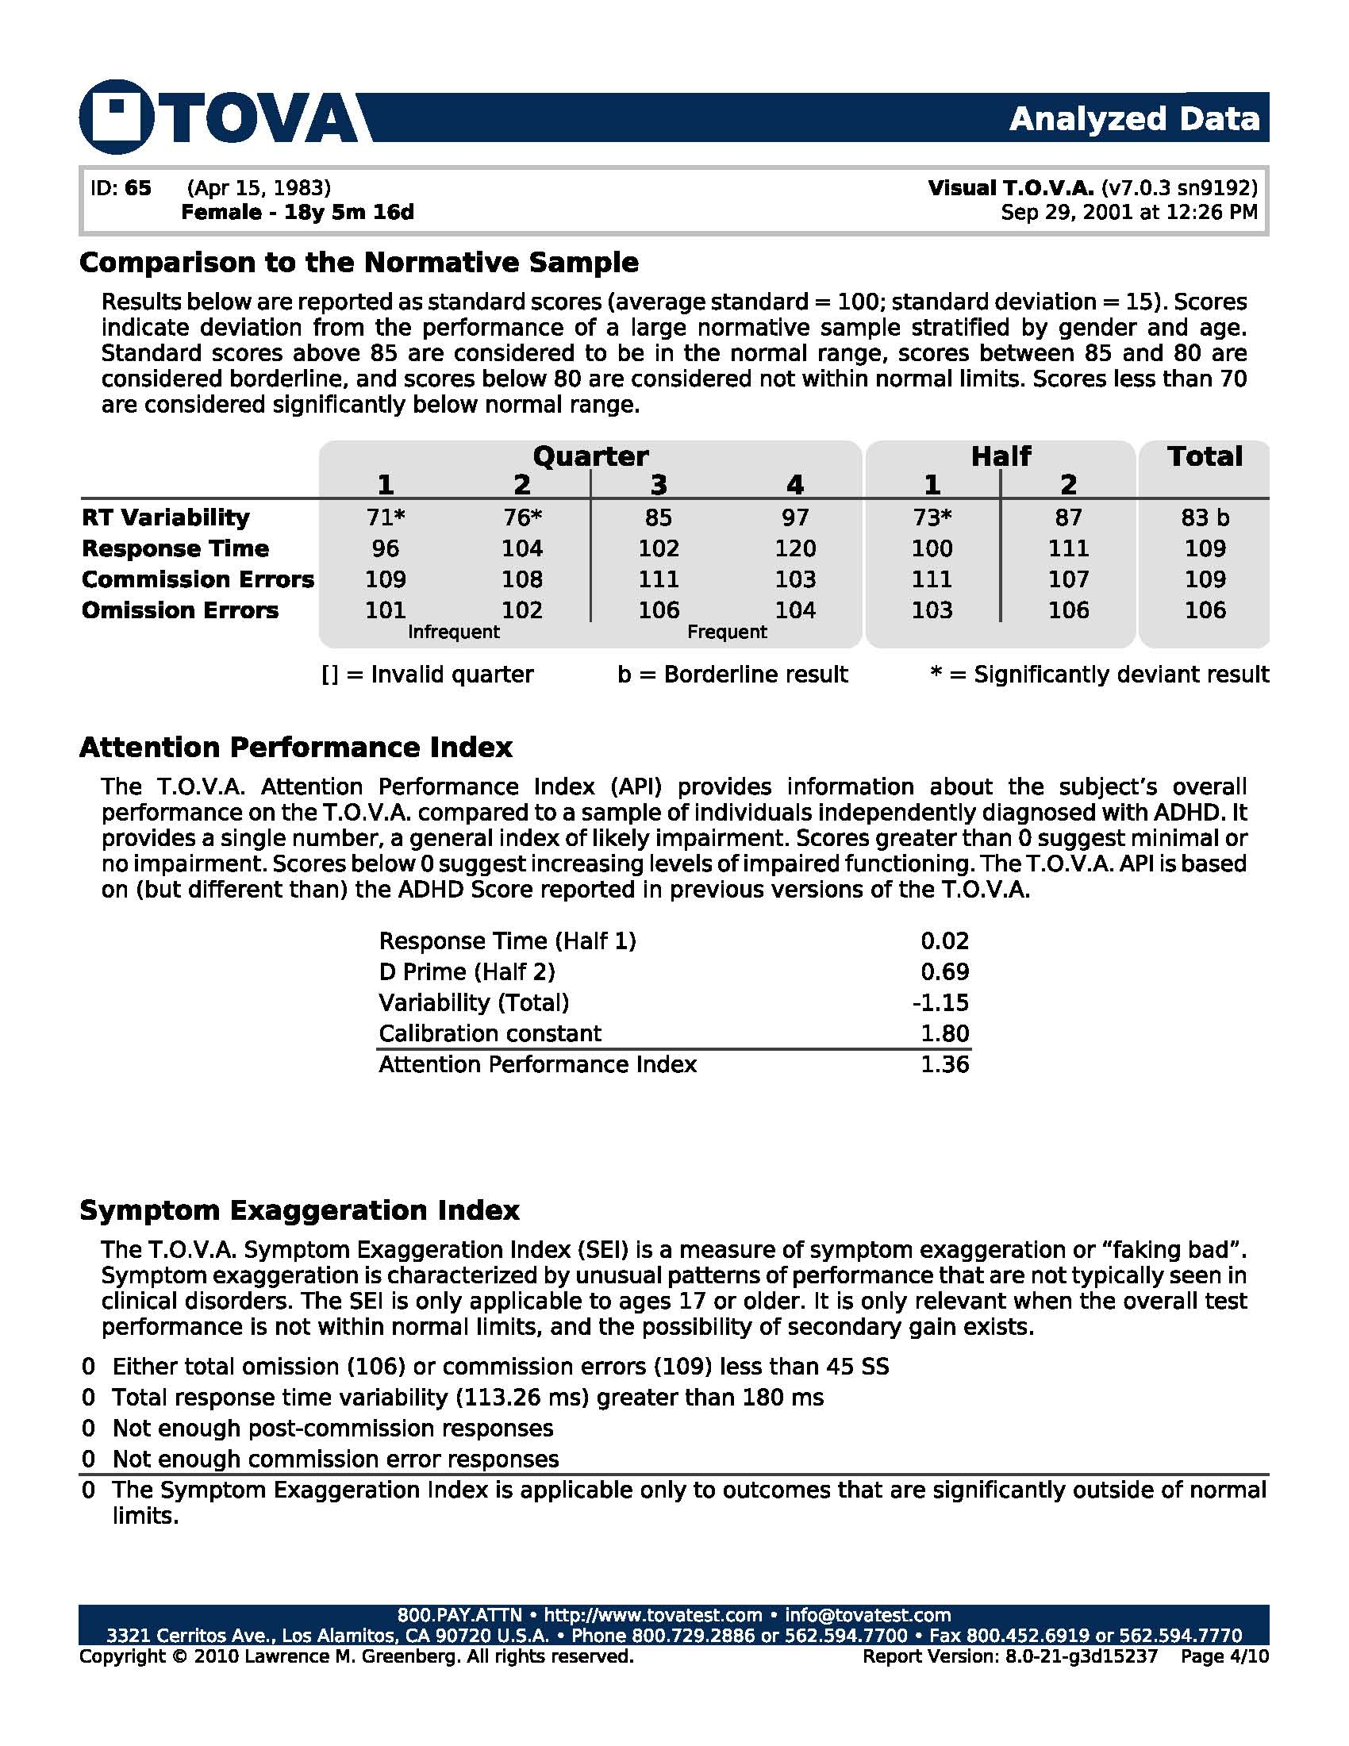

Slide 10
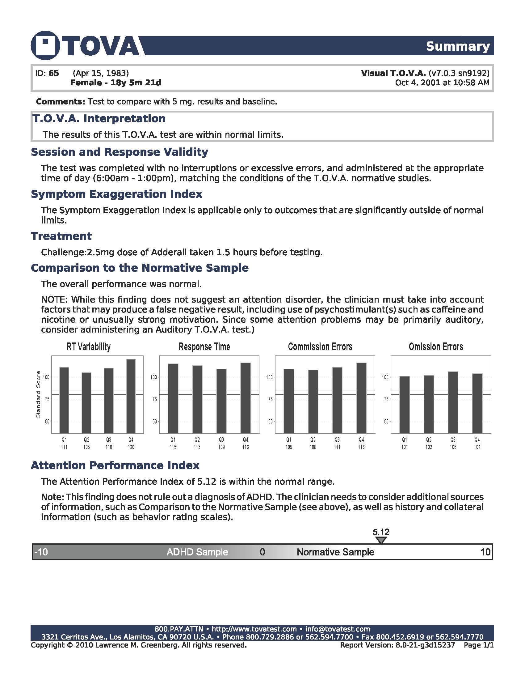

Slide 11
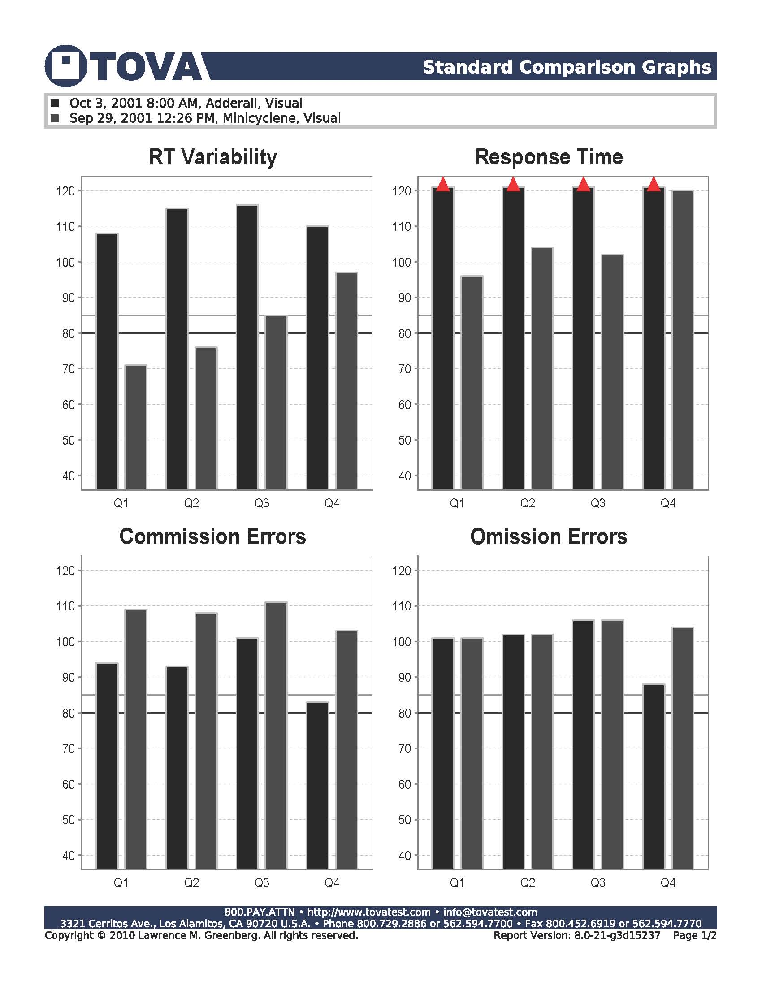

Slide 12
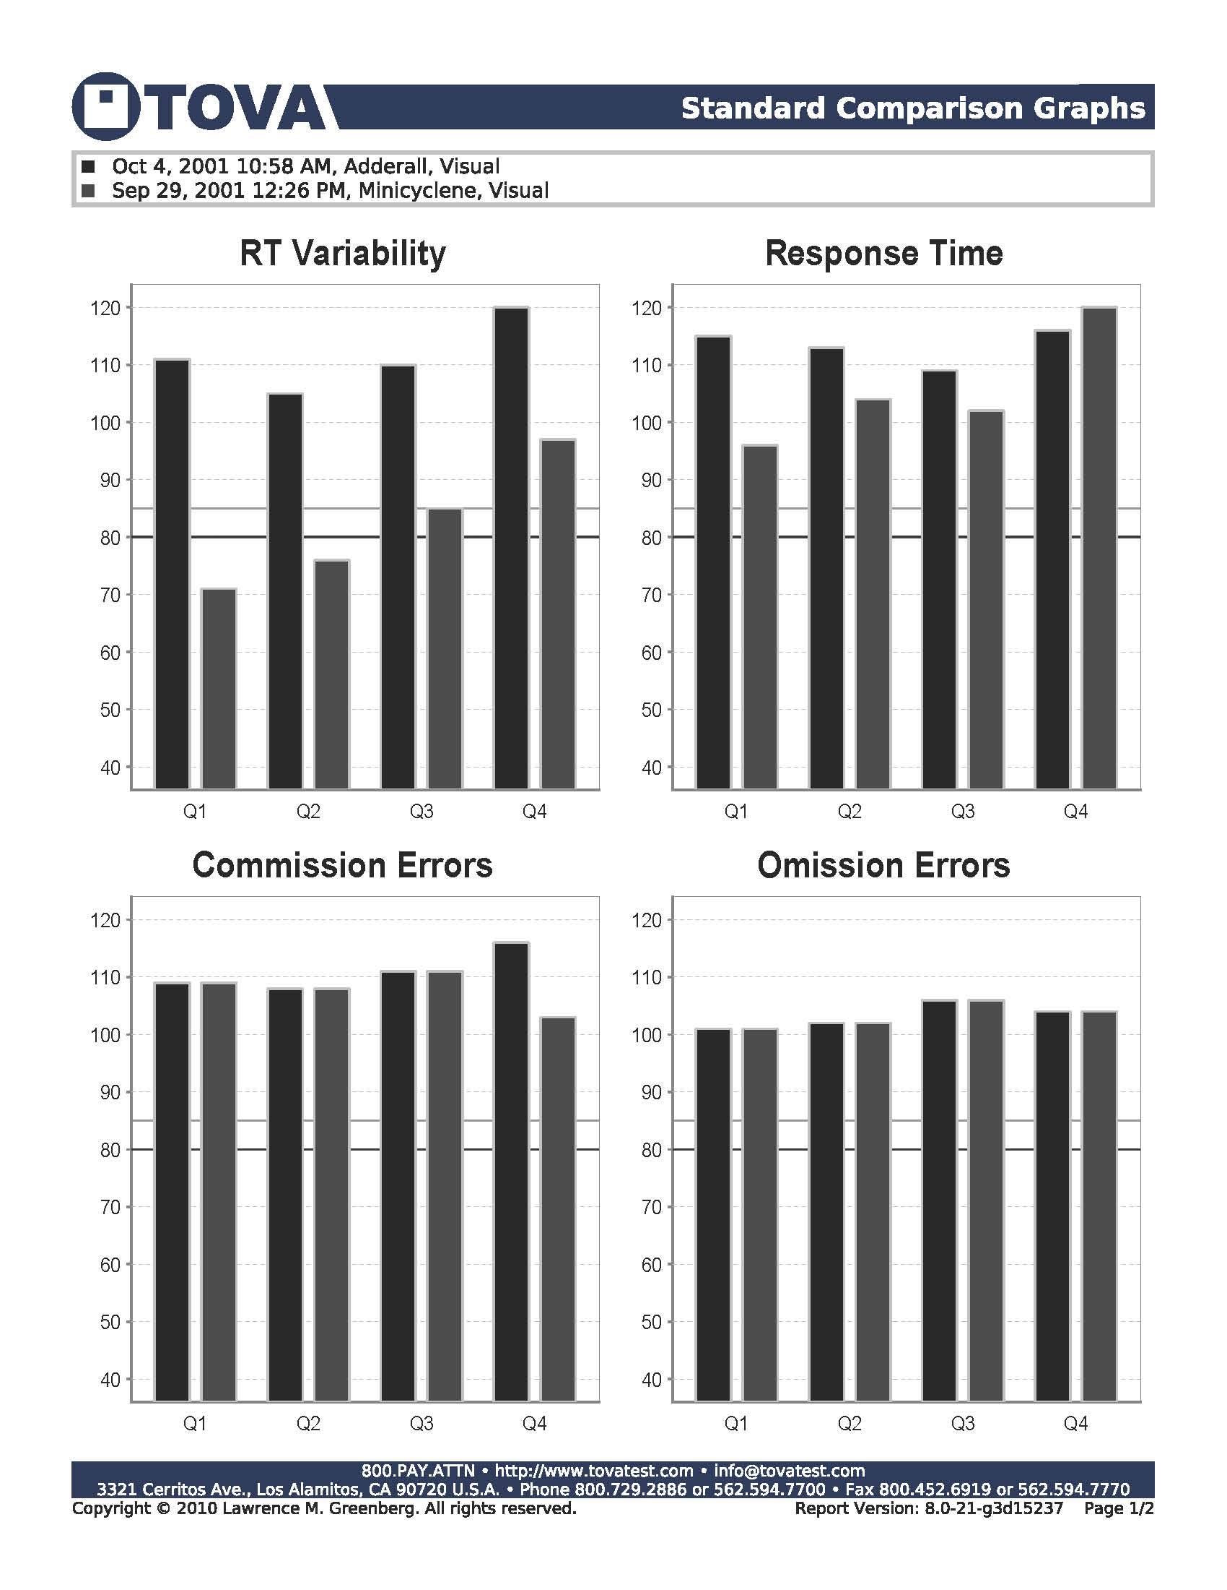

Slide 13
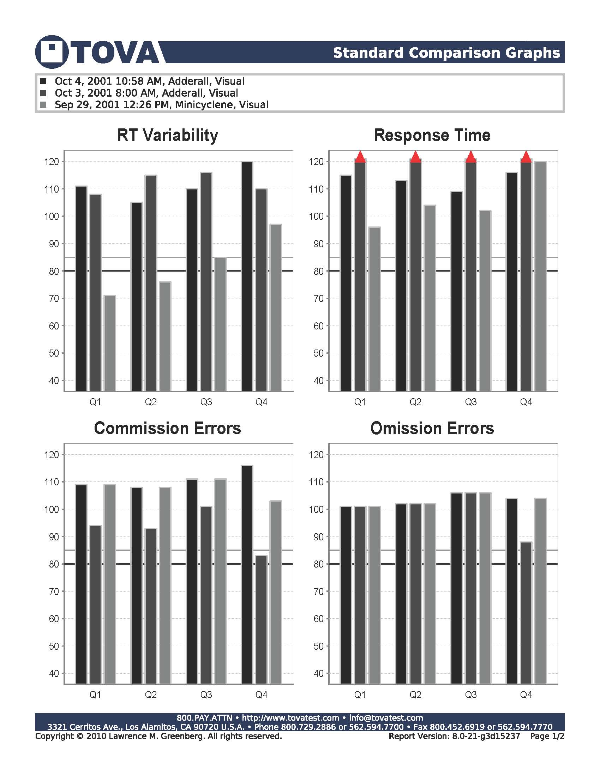

Slide 14
Case Example:
Investigation of high school failure due to inattention
Baseline
Challenge Medication

Slide 16
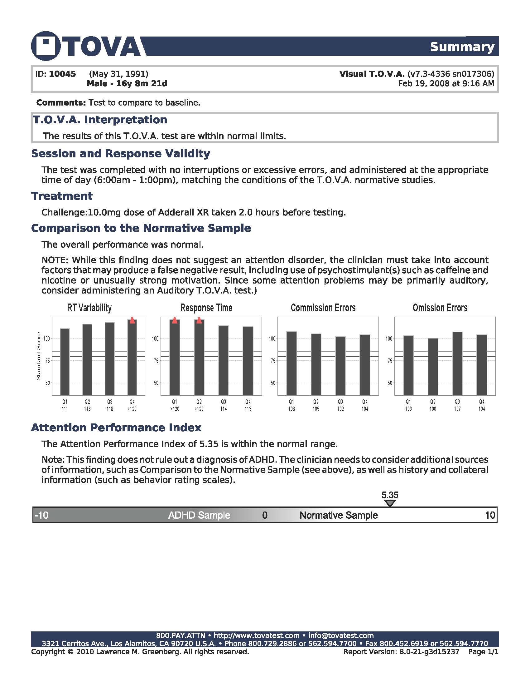

Slide 17
