Slide 1
Attention Deficit Hyperactivity Disorder and the T.O.V.A.
Notes:
This workshop is designed to explore Attention Deficit Hyperactivity Disorder (ADHD) using the Test Of Variables of Attention (T.O.V.A.).

Slide 2
Overview of this Workshop
Attention Disorders, including ADHD
Continuous Performance Tests (CPTs) and the T.O.V.A.

Slide 3
Goals for this Workshop
Promote Empirically-Based Assessment of attention and impulsivity
Improve the lives of children and adults ‘at risk’ for the diagnosis of ADHD
Improve care for children and adults with attention problems

Slide 4
Objectives of this Workshop
The participant will learn about the
DSM IV criteria for ADHD and limitations.
Diagnostic procedures for attention problems.
Treatment modalities for attention problems.
Use and interpretation of the T.O.V.A. in the diagnosis and treatment of attention problems.

Slide 5
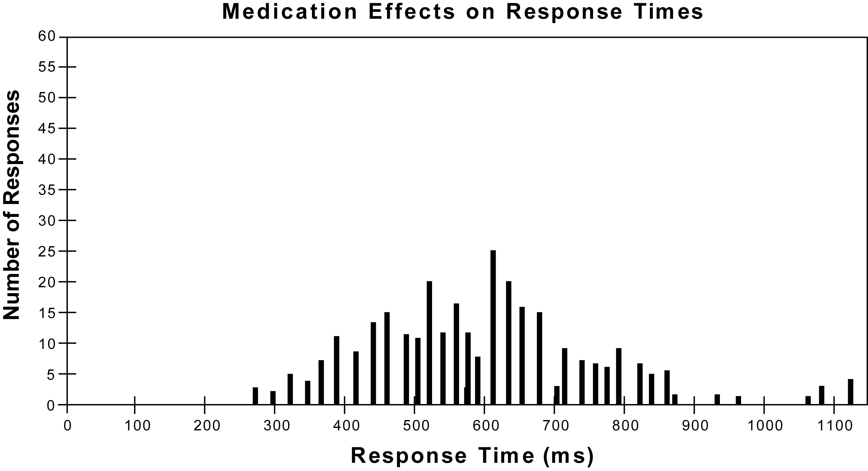
Response Histogram Illustration 1
Notes:
This histogram shows the time (in milliseconds on the horizontal scale) that someone took to press the response microswitch when the target appeared on the computer monitor. The average response time is 600 ms (or six tenths of a second) with a range from 270 to 1100 ms. These results would be similar to what we’d expect from normal six year old boy- but not a girl. (Males and females have different response times.) I said “similar” because it’s not exactly what we’d expect- there are more faster and more slower than expectable responses. The responses aren’t as evenly distributed as we would expect- but more about that later.

Slide 6
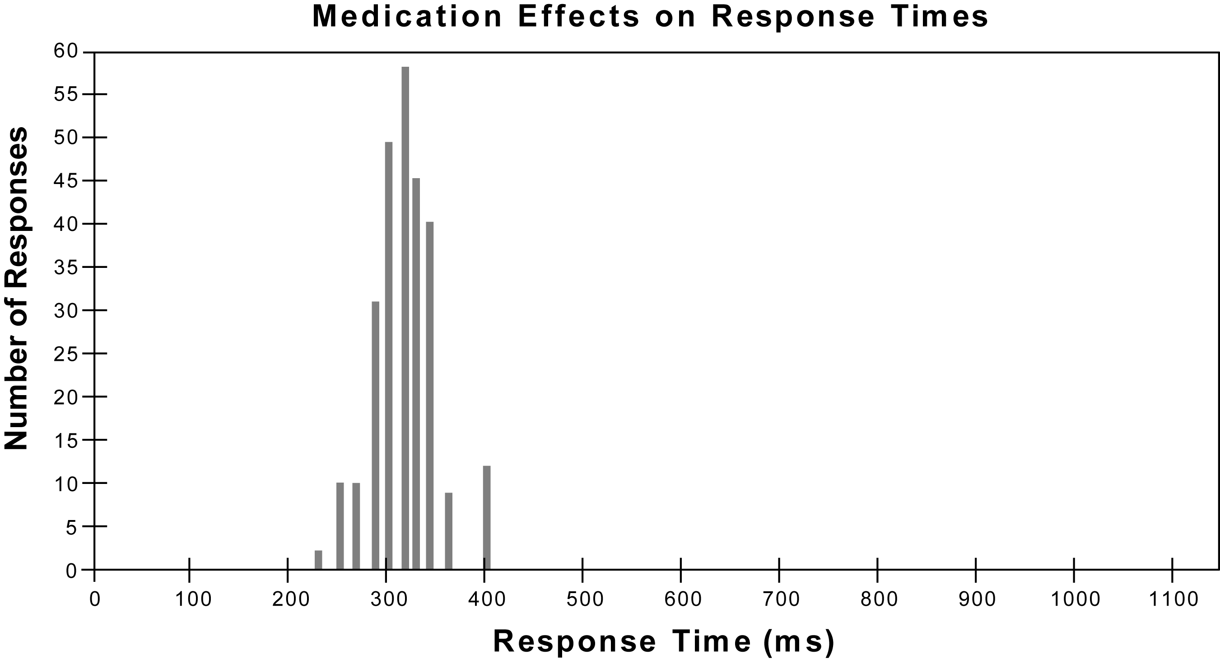
Response Histogram Illustration 2
Notes:
In contrast, this next performance would be perfectly normal for a young man- average response time of 300 ms and a range of 225-400 ms. He’s consistently fast and has evenly distributed responses.

Slide 7
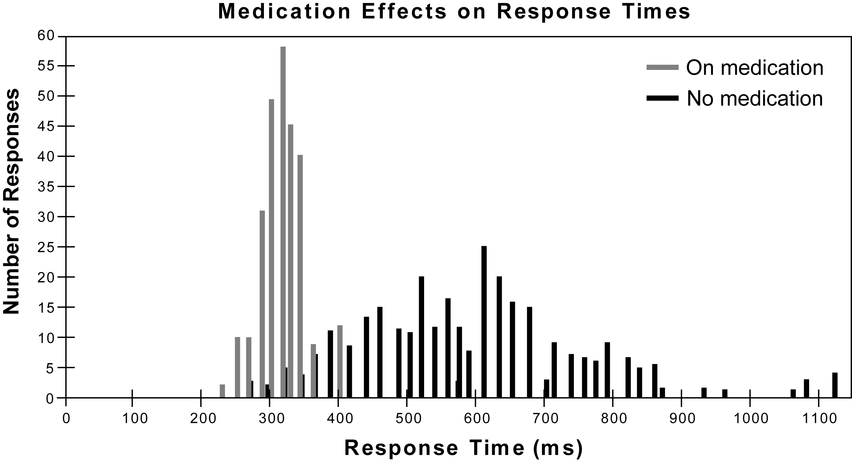
Response Histogram Illustration III
Notes:
Well, here are the two histograms together. The one that we said would be almost normal for a six year old boy (the black lines) was actually the performance of a 24 year old graduate student with a measured IQ above 135. He was responding both significantly slower and faster than normal and sometimes he was very, very slow (like 1 second). If someone was processing information that slowly and inconsistently, there’s no way they could assimilate a graduate level lecture or comprehend a textbook without tremendous effort and numerous re-readings. Even a “simple” with four or five bits of information in it wouldn’t be easy to understand.
The one (the grey lines) that we said would be normal for a young adult male? That’s the same 24 year old graduate student who was recently diagnosed as having the Inattentive Type of ADHD taking the T.O.V.A. a second time the same day, 1.5 hours after taking 2.5 mg of methylphenidate (a very low dose). His performance completely normalizes with half of the smallest available tablet of this short acting psychostimulant (known also as RitalinTM). And four hours later, he’s back to his usual inconsistent responses.
Note that he appeared to be
ｷ 1) processing information and responding very inconsistently, and
ｷ 2) that it took very little medication for his performance to normalize.

Slide 8
Attention I
Attention is best described as the sustained focus of cognitive resources while filtering or ignoring extraneous information. Attention is a very basic function that often is a precursor to many other neurological/cognitive functions. (Wikipedia)
Focused attention: This is the ability to respond discretely to specific visual, auditory or tactile stimuli.
Sustained attention: This refers to the ability to maintain a consistent behavioral response during continuous and repetitive activity.

Slide 9
Attention II
Selective attention refers to the capacity to maintain a behavioral or cognitive set in the face of distracting or competing stimuli. It incorporates the notion of “freedom from distractibility”.
Alternating attention refers to the capacity for mental flexibility allowing individuals to shift their focus of attention and move between tasks having different cognitive requirements.
Divided attention is the highest level of attention and it refers to the ability to respond simultaneously to multiple tasks or multiple task demands.

Slide 10
Attention Span
Average attention span for adults is 20 minutes.
Hyper-focusing is the ability to narrow one’s world down to a task or experience. People often experience losing track of time during these periods.

Slide 11
Terminology
Inattention, distractibility, impulsivity and hyperactivity
- descriptive terms
Symptom-complex- a cluster of symptoms
Attention Deficit Disorders (ADDs)- not diagnostic
Attention Deficit Hyperactivity Disorder (ADHD)
a specific DSM IV diagnosis
a biologically-based psychological process
Target symptom- the focus of treatment
Notes:
1. Inattention, distractibility, impulsivity and hyperactivity, the four current hallmarks of ADHD, are simply descriptive terms that can vary considerably by how they are measured (e.g.: whether subjectively or objectively). In clinical practice, the symptoms tend to be subjectively assessed whether by clinical “global judgment” (the clinician’s impression from observations and history), behavior ratings, and/or symptom checklists.
2. Symptom-complex - We use this term to indicate a group of abnormal behaviors (“symptoms”) that frequently occur together. A symptom-complex can have any number of etiologies (causes) and, therefore, any number of different treatments. As an example, someone complains of a headache with associated symptoms like photophobia and maybe “blurred” vision. It could be caused by tension or anxiety; a head injury; or even a brain tumor. The treatment (and the prognosis) would depend on the cause (or causes) of the symptoms. An aspirin might help one person but not the other. ADHD, as we know it today, is an increasingly well-defined symptom-complex. We’re getting even better at diagnosing the complex (or constellation of symptoms) with increasingly sophisticated behavioral measures. However, as we’ll see later, behavioral measures generally don’t tell us the cause of the complex, only its presence (or absence) and severity.
3. “Attention Deficit Disorders” (or ADD) is used as a descriptive, non-diagnostic term to indicate a heterogeneous group of disorders characterized by inattention and related behaviors that are delineated by behavior ratings and symptom checklists.
4. ADHD refers to the biologically-based psychological process described in DSM IV- more about this later.
5. Of course, we don’t treat syndromes or diseases. We treat individuals with syndromes or diseases by focusing on “targeted” (or “target”) symptoms such as inattention and distractibility. And the more objectively we can measure the target symptoms, the more fine tuned the treatment.

Slide 12
DSM IV Types of ADHD
Predominantly Inattentive Type (314.00)
Predominantly Hyperactive-Impulsive Type (314.01)
Combined Type (314.01)
ADHD Not Otherwise Specified (314.9)
Notes:
The Diagnostic and Statistical Manual, Fourth Edition (DSM IV) provides clinicians the currently approved diagnostic criteria for ADHD.
The four DSM IV sub-types of ADHD are
1 The predominantly Inattentive Type- code 314.00
2. The predominantly Hyperactive-Impulsive Type- code 314.01
3. The Combined Type- code 314.01 and
4. ADHD Not Otherwise Specified- code 314.9

Slide 13
The Diagnostic Criteria for ADHD I
The Predominantly Inattentive Type (314.00) must have six or more of the following symptoms:
Often fails to give close attention to details or makes careless mistakes in schoolwork, work, etc.;
Often has difficulty sustaining attention;
Often does not seem to listen to what is being said;
Often does not follow through on instructions and fails to finish schoolwork, chores, or work (but not due to oppositional behavior or failure to understand instructions);
Often has difficulty organizing tasks and activities;
Often avoids or strongly dislikes tasks requiring sustained mental effort;
Often loses things necessary for tasks or activities;
Often easily distracted by extraneous stimuli; and
Often forgetful in daily activities
Notes:
To diagnose the Predominantly Inattentive Type (314.00), the person must have six or more of the following symptoms:
1. Often fails to give close attention to details or makes careless mistakes in schoolwork, work, etc.
2. Often has difficulty sustaining attention
3. Often does not seem to listen to what is being said
4. Often does not follow through on instructions and fails to finish schoolwork
5. Often has difficulty organizing tasks and activities
6. Often avoids or strongly dislikes tasks requiring sustained mental effort
7. Often loses things necessary for tasks or activities
8. Often easily distracted by extraneous stimuli
9. Often forgetful in daily activities
“Often”- often? How is that measured? In what circumstances? When the TV is blaring, dinner’s being made, and the dog is chasing the cat? When upset?

Slide 14
The Diagnostic Criteria for ADHD II
The Predominantly Hyperactive-Impulsive Type (314.01) must have six or more of the following symptoms:
Often fidgets with hands or feet or squirms in seat;
Often leaves seat in classroom;
Often runs about or climbs excessively (For adolescents or adults, may be limited to feelings of restlessness);
Often has difficulty playing quietly;
Often blurts out answers to questions too soon;
Often has difficulty waiting in line or waiting for turn.
Often blurts out answers before questions have been finished.
Often has trouble waiting one’s turn.
Often interrupts or intrudes on others (butts into conversations or games).
Notes:
To diagnose the Predominantly Hyperactive-Impulsive Type (314.01), the person must have four or more of the following symptoms:
1. Often fidgets with hands or feet or squirms in seat
2. Often leaves seat in classroom
3. Often runs about or climbs excessively or
For adolescents or adults, may be limited to feelings of restlessness
4. Often has difficulty playing quietly
5. Often blurts out answers too soon
6. Often has difficulty waiting in line or waiting for turn

Slide 15
ADHD- Combined and NOS III
The Combined Type (314.01) has both inattentive and hyperactive/impulsive symptoms.
ADHD Not Otherwise Specified (314.9)
Adults and adolescents with ADHD who do not meet criteria for 314.0 or 314.01, but are affected by symptoms of ADHD
Notes:
The two remaining types are
1. The Combined Type (314.01) has both inattentive and hyperactive/impulsive symptoms
ADHD Not Otherwise Specified (314.9) for adolescents and adults who do not meet criteria for 314.00 or 314.01
Adele Diamond says ADHD is DAT1 gene and ADD is DRD4 gene. ADHD is frontal striatal and ADD is frontal parietal.

Slide 16
Diagnostic Requirements for ADHD
There must be the necessary number of symptoms from the lists above, and
Each of the following criteria must be met: The onset of symptoms is no later than seven years of age
The symptoms must be present in two or more situations (like home and school);
There must be clinically significant distress or impairment in social, academic, or occupational functioning;
The condition can not be caused by another psychiatric illness like Pervasive Developmental Disorder, Schizophrenia, or other psychotic disorder of mood, anxiety, dissociation, or personality.
Notes:
The diagnostic requirements are:
1. There must be at least 6 symptoms above to qualify for the diagnosis of 314.00,
4 for 314.01, and 10 for the combined type
Each of the following criteria must be met:
The onset of symptoms must be no later than seven years of age
Symptoms must be present in two or more settings (like home and school)
c. There must be clinically significant distress or impairment in social, academic, or occupational functioning
d. The condition cannot be caused by another psychiatric illness

Slide 17
Limitations of DSM-IV category of ADHD I
1. ADHD is a symptom-complex not a disorder
- Multiple etiologies, treatments and prognoses
2. Diagnostic criteria are behavioral and subjective
3. Impairment is subjectively determined
Notes:
Limitations I
There are serious limitations of the current DSM IV category of ADHD, including:
1. Since ADHD is a symptom-complex, there are multiple etiologies and treatments
2. Diagnostic criteria are subjectively, not objectively, determined by clinical judgment and sometimes with behavior ratings and symptom checklists
Please note that I’m not saying that ratings and checklists shouldn’t be used. On the contrary, they are necessary even though they are subjective measures. And, unfortunately, many clinicians don’t use them.
3. Degree of impairment is also subjectively determined

Slide 18
Limitations of DSM-IV category of ADHD II
4. Symptoms are situation specific, age-linked, and culture bound
5. Symptoms often become manifested after age 7
6. ADHD is confusing
Notes:
Limitations II
Additional limitations include:
1. Symptoms are situationally specific, age-linked and culture bound
Situationally specific- What if you don’t need to sit in your classroom and print the letter “a” twenty-five times to learn the lesson? What if you have an uninspiring teacher? An excellent teacher? Or what if your family successfully makes all or many of the necessary adjustments so that your world is designed to accommodate you?
Age-linked- Most adults with ADHD don’t wander about the classroom, and many teenagers and adults learn valuable “coping strategies” to minimize their symptoms- like working in a quiet, non-distracting room, not in the kitchen.
Culture bound- Behavior is significantly affected by the culture. In some settings being hyper-alert and scanning for possible danger may be more useful than focusing in on something else, particularly something boring and irrelevant..
2. Symptoms often become manifested after age 7. Remember the graduate student represented in slides 6-8? He wasn’t symptomatic until high school.
One 61 year old woman with a PhD in chemistry was seen because her work deteriorated dramatically soon after she became a vice-president in a large, well known corporation. She’d been the successful director of her laboratory with a number of scientists working very productively for her. The HR staff referred her because her symptom checklist clearly indicated an attention problem. She intuitively knew that she was very distractible visually and aurally and had always been able to find quiet, calm places. However, her new office had large windows overlooking a park frequented by young children, and her secretaries kept coming into her office with important messages. Once she understood the problem, she made a few changes in her office (repositioned her desk so her back was to the windows, reduced secretarial traffic into her room, closed the door to the corridor) and responded well without the need for medication.
3. The “Hyperactivity” of ADHD is misleading. Half of the children and most of the adults with ADHD are not hyperactive. Unfortunately, the non-hyperactives often don’t get diagnosed until much later, if at all, since they don’t bother anybody else.

Slide 19
Limitations of DSM IV Category of ADHD III
7. Ability to “hyperfocus” is not addressed
8. Traumatic Brain Injury (TBI) not explicitly
excluded
9. Absence of “executive functions” in
symptom-complex
10.Must consider the manner in which symptoms may manifest in girls versus boys
Notes:
Many persons with ADHD can hyperfocus. They can stay on a task of considerable interest to them- like computer games.
One well known computer programmer with ADHD had his new office building designed so that he (and a number of his senior staff) worked in what we would recognize as a sound chamber with no windows, gray walls and carpeting, etc. He could work for hours in that room. Fortunately, his wife, a contented “picker-upper-after the cyclone wandered by”, didn’t seem to mind that he spent many hours in his basement office away from the kids, pets, etc.
Individuals with any number of neurological conditions like Traumatic Brain Injury (TBI), dementia and sleep disorders often have attention disorders. Do they have ADHD as well? It’s not clear.
Problems of executive functions weren’t included as diagnostic criteria. We must wait until DSM V. So what are executive functions?

Slide 20
Executive Functions I
Necessary for effective planning and problem solving
Identify and prioritize problems
Select, retrieve and /or gather, and organize pertinent data
3. Select an appropriate problem solving strategy
4. Organize, analyze, and interpret relevant data
5. Evaluate results and process
6. Working memory
Notes:
Executive Functions I
These are the skills necessary for effective planning and problem solving. They include the ability to
1. Identify and prioritize problems
2. Select, retrieve and/or gather, and organize pertinent data
3. Select an appropriate problem solving strategy
4. Organize, analyze, and interpret relevant data
5. Evaluate results and process
6. Working memory

Slide 21
Executive Functions II
Focusing and filtering (in and out--selective
attention)
8. Affect regulation
9. Behavior regulation (e.g., impulse control)
10. Regulate arousal level
11. Regulation information processing
12. Maintain motivation
Notes:
Executive Functions II
7. Focus and filter (that is, maintain selective attention)
8. Regulate affect
9. Regulate behavior (that is, impulse control)
10. Regulate arousal level
11. Regulate information processing (that is, control variability)
12. Maintain motivation
Problems in these and related skills are being considered for inclusion in the ADHD symptom-complex in DSM V
Adele Diamond: Inhibitory Control, Working Memory, Cognitive Flexibility

Slide 22
What do these all have in common?
Depression Oppositional defiant disorder
Anxiety Learning disability
Tourettes syndrome Poor social history
Toxins (e.g.: lead poisoning) Poor hearing
Auditory processing problems Sleep problems
Language disorder Physical or sexual abuse
Post-Traumatic Stress Disorder Executive dysfunction
Head injury Neurological disorders
Intellectual precocity/impairment Family style
Sensory anomalies Poor school “fit”
Medications Dementias
Hearing loss Visual impairment
Etc.

Slide 23
They are all mistaken for ADHD

Slide 24
Causes of the ADHD Symptom Complex I
Normal (including “Active Alert”)
General Medical problems
Neurological problems (other than ADHD)
Sensory deficits and hypersensitivities
Traumatic Brain Injuries (TBI)
Intellectual impairment (and precocity)
Learning disabilities
Dementias
Sleep disorders
Seizures
Medications
Notes:
Causes I
The causes of inattention and impulsivity are many and often co-exist. That is, co-morbidity (the presence of at least two of these causes together) with ADHD is usual. It is actually uncommon for someone with ADHD to not have at least one other contributing problem. But let’s briefly look at them one by one. We’ll be talking about many of them later in more detail.
1. Normal? Yes there are a number of kids, called “active alert” by Dr. Linda Budd, who are inquisitive, active, and bright and who “bug” their parents who would like a nice quiet weekend or evening. There’s nothing wrong with these kids- they’re simply high energy types. We’ll see an example of this later when we review some T.O.V.A. protocols.
2. Many medical problems can appear with many of the ADHD symptoms. Hyperthyroidism would be one example, but there are many.
3. Many neurological disorders other than ADHD can produce an ADHD picture. Seizures, traumatic brain injuries, sleep disorders, dementias- just to name a few. Ever wonder what percent of injured and stress disordered war veterans have ADHD secondary to TBI (traumatic brain injuries)?
4. Sensory deficits (like untreated hearing loss or visual impairment) and any of the uncommon but possible hypersensitivities (like to smell or touch).
One of my first patients in child psychiatry was a baby carried into the clinic on a pillow by his distraught-appearing mother who was followed by six young children. My first thought was that mom was the patient. Fortunately, before I could ask any damning questions, she told me that, unlike her other children, this one got upset and cried whenever he was touched, even to be breast fed. So she holds him on a pillow, and he does fine. Perhaps he has “touch pain”? she asked. “And what do I tell my neighbors who think I’m strange?” After advising her that her son was, indeed, kinesthetically hypersensitive, that it would improve over time, and she was doing the right thing, she left with a smile on her face.
Okay, that was an unusual example. How about an individual who doesn’t tolerate strong odors like perfume, cigarette smoke, or even aftershave lotion?
Many medications (like anticonvulsants, antipsychotics, and antihistamines) affect the CNS
and can produce the symptom complex of ADHD.

Slide 25
Causes of ADHD Symptom Complex II
Family style and organization
School readiness, learning style, and motivation
Stress
Notes:
Causes II
1. Some families have styles that are not the same as the predominant culture and, if you will, “train” their children “differently” than others. And some families are at best disorganized and unable to train their children.
2. School readiness- not all children are taught to sit quietly, fold their hands together on their desk, and look eager to be taught. Some children may have a different learning style than the teacher’s prepared for- as an example, some children learn best with a “hands on” experience rather than a listen and repeat routine. And, let’s face it, some classrooms aren’t relevant to the life experiences of some children.
3. And yes, some kids are quick (that is bright) and don’t need to be told some things more than once or twice- they get it. But some kids are slow learners. It’s important to know.
4. Children and adults with learning disabilities often have trouble staying on task but may not have ADHD. It’s estimated that one third of individuals with ADHD have learning disabilities and visa versa.
5. Stress can certainly cause off-task behavior. What if the child’s mother is severely ill?

Slide 26
Causes of ADHD Symptom Complex III
Psychiatric conditions
Substance use, abuse and withdrawal
Anxiety
Depression
Bi-Polar
Behavioral disorders: Conduct Disorder, ODD
Malingering
Pervasive Developmental Disorders
ADHD
4-5% of adults
9.5% of children
Notes:
Causes III
1. Many psychiatric disorders present with many of the same symptoms as ADHD. In particular, we need to consider bipolar, post-traumatic stress, depressive, and obsessive-compulsive disorders.
Of course, many children and adults with ADHD develop less severe, yet bothersome problems, like low self-esteem, that may persist even though the ADHD may be “outgrown”.
2. Substance use includes caffeine and nicotine, not just the illegal chemicals, and some individuals are use toxic amounts. It’s important to remember that abrupt withdrawal of these substance can cause ADHD-like symptoms. Want to find a large percentage of nicotine and caffeine abusers? Visit a substance abuse treatment program, and you’ll see a lot of folks who are trying to self-medicate. Unfortunately, they are usually over-treating themselves and actually making themselves worse.
Substance use/abuse and ADHD together is a good example of co-morbidity. When we identified the substance abusers in a treatment program who also had underlying ADHD and effectively treated the ADHD (yes, with low dose psychostimulants), their substance abuse was much easier to treat. We’ll talk more about this later.
3. Behavior disorders, like conduct disorders, are difficult to differentiate from ADHD, and they often occur together.
4. Malingering (faking bad)? A cause of ADHD-like symptoms? Ever wonder how many college students show up in the health service saying they have ADHD and asking for psychostimulants and accommodations when they DON’T really have ADHD?
5. And finally- just plain old ordinary ADHD that occurs in 5% of adults and 7-8% of children.
Question- Why is the number of diagnosed cases of ADHD increasing as is the number of children and adults being treated with psychostimulants?
ｷ Is it because there’s been so much publicity about ADHD that it’s the “disease of the decade”, as one skeptic once commented.
(If so, it’s being eclipsed by an apparent epidemic of bi-polar disorder cases. But that’s another story.)
ｷ Is the increase because our life styles, diets, toxic exposures, family dysfunctions, etc., are increasing?
ｷ Is it because we aren’t differentiating among the different causes of the symptom complex?
ｷ How much is due to increased awareness and picking up the cases that were missed in the past- like adult cases and non-hyperactive cases?
These are all possible and must be considered.
So what is ADHD? Once you’ve worked through the causes of inattention and impulsivity and decided on ADHD (keeping in mind the frequent occurrence of comorbid conditions)- what is it? What causes it? How should it be treated?

Slide 27
Response Time Histogram Comparison
Notes:
Histogram
Here’s a T.O.V.A. illustration that confirms some of the theoretical constructs. Two 9 year old boys are asked to press a response button as quickly as they can when the target flashes on the screen. (It’s like a computer game.) The normal 9 year old boy (the curve on the left) responds on the average of 480 ms ± 80 ms; however, the 9 year old with ADHD (the curve on the right) takes 700 ms ± 150 ms to respond- his response times are much more variable (or inconsistent) and sometimes faster and sometimes slower. For whatever reason or reasons, the youngster with ADHD is responding so inconsistently (variably) that he can’t process the information consistently and rapidly enough to respond correctly. No wonder he becomes off-task or inattentive, impulsive, and distracted. He’s not being successful- no wonder his self-esteem suffers. He can develop any number of “coping strategies” like becoming the class clown, the trouble-maker, the wall flower, etc., to avoid feeling like a “loser”. Sure he gets negative consequences (punishment) and gets angry, but now he can blame others for what they’re doing to him. Feeling guilty for “acting up” is more comfortable than feeling the shame of failure.

Slide 28
Diagnosing ADHD I
History
Behavior ratings
ACTeRS, SBCL, BASC-2, BAADS, CTRS-R, Vanderbilt
Symptom behavior check list
4. Mental Status Exam
Continuous performance tests (CPTs)
Notes:
Diagnosis I
Here are the different steps involved in making a diagnosis of ADHD and co-morbid conditions. Look formidable? Well, it is. It takes time, expertise, and money to do a comprehensive diagnostic evaluation, and, many times, it’s not necessary. Of course, most clinicians have only some of these skills. In fact, very few clinicians have the training, let alone the time, to do more than the basic minimum- those steps that give us sufficient information to make a relatively clear diagnosis and to determine whether more needs to be done before initiating treatment.
And sometimes, even when there is more than one problem, it makes sense to begin the treatment of the most pressing and/or most easily treated problem and to see what happens. If, for instance, ADHD is accompanied by a moderately severe depression, the clinician may want to treat the depression first. With a minor depression and ADHD, it might be best to treat the ADHD first since the depression may improve as the person has more success. Similarly, with ADHD alone, many times treating the inattention and distractibility will result in less impulsivity and hyperactivity.
By the way, the generic term, “clinician”, is being used to remind us that many physicians, nurse clinicians, and psychologists are not experts in ADHD. Even many of us with specialized training in neurology, psychiatry, pediatrics, and neuropsychology may not be experts in ADHD. And even some of us with considerable experience and expertise in ADHD may have limiting professional biases or opinions and may not be knowledgeable of important new findings.
Okay, the steps in diagnosing ADHD:
1. History- the first and most important step. Taking the time to listen carefully to the identified patient and family is not easy in this age of 15-30 minute appointments. Never-the-less, a good history is essential to making a good diagnosis and determining the degree of co-morbidity. Screening questionnaires can be very helpful and time saving.
2. A behavior rating such as the BASC-2 and the others listed on the slide is also an essential. For children, we’d want a rating by the teacher and one by the parent(s). For an adult, we’d want a self-rating and perhaps one by a significant other. Yes, they are subjective measures, but, ADHD is currently defined as a particular symptom complex- a group of symptoms. Thus, the diagnosis is based on the presence or absence of those symptoms and their severity.
Speaking of behavior ratings, we need to remember that unlike the more recently published and well designed ratings, most of the earlier ones with which decisions about treatment were made were not particularly well constructed and certainly not well normed.
3. A DSM IV symptom behavior checklist is a reasonably good (although still subjective) way to determine severity of the symptoms and to help determine the effectiveness of treatment.
4. Clinicians can conduct a “mini” mental status examination (an interview) of the patient to help determine whether more in-depth evaluations are needed, particularly to assess co-morbid conditions.
5. Continuous Performance Tests (CPTs) like the T.O.V.A. We’ll skip over them for now and spend more time later talking about how they are used in the diagnosis and treatment of ADHD.

Slide 29
Diagnosing ADHD II
6. Physical and neurological exams
7. Psychological, psychiatric, and neuropsychological evaluations
8. Evaluation of classroom/work place
Notes:
Diagnosis II
6. A recent physical and screening neurological examination, by the family doctor or pediatrician is important, especially to determine if referrals to specialists, such as a neurologist and a sleep disorders facility, are indicated.
7. Similarly, the clinician needs to consider whether psychological, educational, neuropsychological, and/or psychiatric evaluations might be helpful in a given case. Extensive and costly evaluations are not routine procedures in diagnostic work-ups for ADHD. However, they are invaluable in a number of cases, particularly with co-morbidity.
8. Evaluation of classroom/work place can be very helpful both in the diagnostic and treatment phases. Although a behavior rating from the teacher is helpful, in-class observations can be very helpful, especially when designing a classroom intervention. However, since classroom observations are costly, they are not often obtained. Work place observations and interviews with supervisors and co-workers can also be very helpful although confidentiality concerns usually prohibit them.
9. Structured interviews are very helpful, particularly to determine co-morbidity issues; however, they are very time consuming and generally restricted to research.
10. Neuro-imaging may very well turn out to be a costly but valuable diagnostic and treatment monitoring tool; however, much more research needs to be conducted.

Slide 30
Comorbidity is the rule, not the exception
58% - 87% of children diagnosed with ADHD have at least one comorbid disorder
Up to 20% may have three or more comorbid disorders
Most common comorbid conditions:
Oppositional Defiant Disorder (54% to 84%)
Learning Disability or Language Disorder (25% to 35%)
Anxiety disorder (up to 30%) – up to 50% have some symptoms
Mood disorder (up to 33%)
Substance Abuse (ADHD 5-10x more common in adult alcoholics than non-alcoholics)

Slide 31
Co-morbidity by Type I
Predominantly Inattentive Type:
21% had Oppositional Defiant Disorder
21% had Minor Depression Dysthymia Disorder
19% had Generalized Anxiety Disorder

Slide 32
Co-morbidity by Type II
Predominantly Hyperactive-Impulsive Type:
42% had Oppositional Defiant Disorder
22% had Generalized Anxiety Disorder
19% had Minor Depression Dysthymia Disorder

Slide 33
Co-morbidity by Type III
Combined Type:
50.7% had Oppositional Defiance Disorder
22.7% had Minor Depression Dysthymia Disorder
12.4% had Generalized Anxiety Disorder

Slide 34
ADHD vs. Pediatric Bipolar Disorder?
PBD is certainly over diagnosed
50% diagnosed were PBD reclassified as depression or conduct disorder when given research-based assessment
Many symptoms are misinterpreted:
Social “activation” in ADHD
“Explosive” behavior in ODD
“Mood swings” loose term, can have multiple causes
“Episodes” can be secondary to stressors
Sexual precocity can arise from sexual abuse or exposure to pornography
34

Slide 35
Treatment of ADHD I
Establish diagnosis and provide information
Psychotherapy: Parental/Spousal counseling, school/workplace, vocational, recreational
Coaching
Notes:
Treatment I
1. Making the diagnosis, defining the symptoms, and providing information about the expectable course of the condition without even mentioning potential treatment options can be reassuring and therapeutic. Many persons with ADHD develop low self-esteem, recognizing that they aren’t performing up to expectations (theirs and others’). They begin to believe what they may be hearing- “You’re not trying hard”, “You don’t care”, “You’re lazy or dumb”, You’re bad.” They know something is wrong but not what it is. Many a parent will deeply exhale and relax (until they begin to worry about medication). Some adults will slump and tear and then get angry- “Why wasn’t this diagnosed and treated long ago?” Sometimes parents and adults with ADHD can figure out what will help once they know what the problem is. If they’re distractible, they reduce distractions, etc.
2. “Coaching” refers to a relatively new profession of individuals who coach or advise parents and people with ADHD how to manage it at home, work/school, and in social situations. Some coaches can provide considerable support and helpful directions for coping with the symptoms of ADHD.
3. Parental/couples counseling may be very similar to what a good coach can provide- helping parents learn how to provide firm, consistent, expectable and reasonable consequences, meaningful rewards for effort and success, and patience and love. For significant others, it is helpful to review the diagnosis and symptoms with the person with ADHD present and to guide them both to think about and make practical changes that minimize symptoms. Many of these ideas can be found in the T.O.V.A. Home Intervention Report that can be tailored for each intervention.
4. Consultations to the teacher, school psychologist and/or employer can be very helpful. If there’s a choice of teachers for next year’s class, select the one who works best with ADHD kids. The T.O.V.A. Classroom Intervention Report can be used to communicate any number of strategies to help the child.
There are usually some accommodations that the employer can make that will minimize the ADHD related problems. Remember the scientist who responded quite well to decreasing the distractions in her new office?
5. Vocational counseling can be very helpful, especially for high school and college students in the process of deciding what they want kind of work they want. Obviously, if they have attention problems, they might want to avoid professions like accounting. On the other hand, programming and working with computers may be a natural, especially for those who can hyperfocus.
6. Recreational counseling can help individuals with ADHD find gratifying activities for their leisure time. Bridge may not be ideal, but tennis could be.
________________________________________________________________________________________________________________________________________________________________________________________________________________________________________________________________________________________________________________________________________________________________________________________________________________________________________________________________________________________________________________________________________________________________________________________________________________________________________________________________________________________________________________________________________________________________________________________________

Slide 36
Treating ADHD II
Neurofeedback
Behavior modification
Dietary considerations
Meditation
Medication
Notes:
Treatment II
7. The topic of neurofeedback generates a great deal of strong feelings - some colleagues consider it a waste of time, others consider it the treatment of choice for ADHD. The research literature clearly supports the efficacy of biofeedback, and there are a number of well documented successes, using objective outcome measures like the T.O.V.A. However, there remain many unanswered questions, and the cost is not trivial.
8 & 9. Behavior modification as well as psychotherapy can be very useful in selected cases although the research literature clearly supports pharmacotherapy as the more efficacious treatment of ADHD.
10. Dietary interventions are frequently sought to take the place of medication. The research literature is, at best, equivocal. While a limited number of individuals with ADHD appear to improve with dietary changes, pharmacotherapy is clearly more efficacious.
11. Medications- well, let’s talk about medications.

Slide 37
Measuring Symptoms and Treatment
Subjective measures
Reports and history
Behavior ratings
Symptom checklists
Global clinical judgment
Objective measures
Psychological and educational tests
CPTs
Notes:
________________________________________________________________________________________________________________________________________________________________________________________________________________________________________________________________________________________________________________________________________________________________________________________________________________________________________________________________________________________________________________________________________________________________________________________________________________________________________________________________________________________________________________________________________________________________________________________________

Slide 38
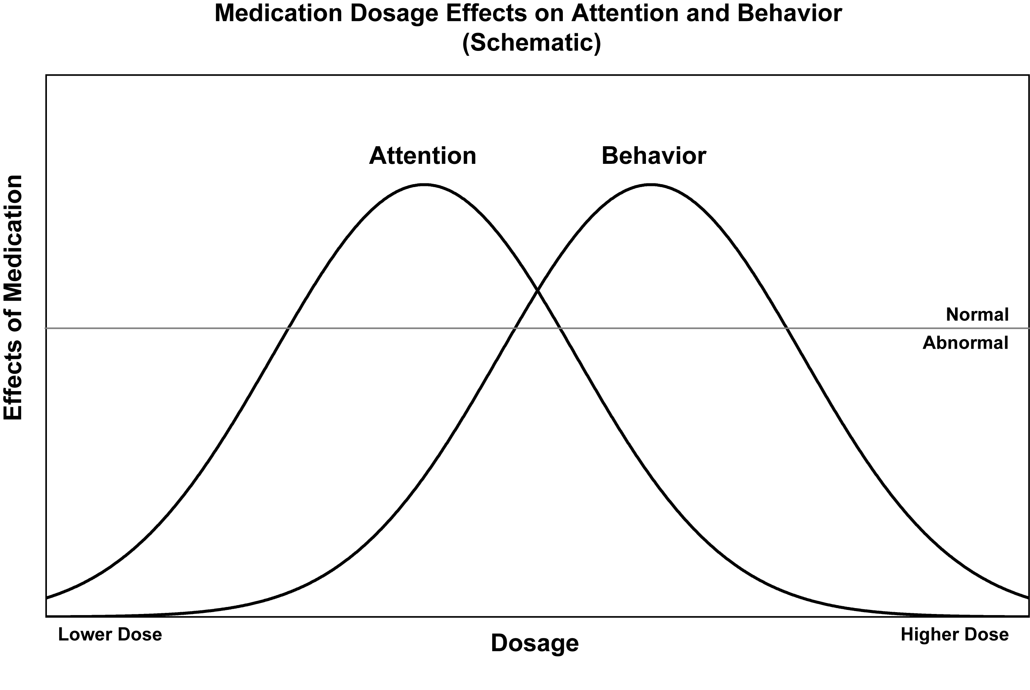
Medication Dosage Effects on Attention and Behaviour (Schematic)
Notes:
Effects of low and high doses of psychostimulants. This research was done with the T.O.V.A., but there are many other studies demonstrating the same findings- that low doses affect attention primarily. Yes, behavior generally improves with low doses, particularly over time, but not as quickly as with high doses. However, when you increase the dose to change behavior- look what happens to attention. It actually worsens, and the occurrence of side effects and noncompliance increase. So why do we use higher than necessary doses? Actually, it’s very simple- Until recently, but even now, the pharmacotherapy research is based on behavior ratings and symptom checklists. Yes, they’re subjective measures, but, more to the point, they are constructed in such a way that the ratings are most sensitive to the most bothersome behaviors (hyperactivity and impulsivity) that are more easily observed than inattention and distractibility are. Now, when you use objective measures of attention; voila, low doses are best. More about doses later.
Sprague, R.L. & Sleator, E.K. (1977) Methylphenidate in hyperkinetic children: Differences in dose effects on Learning and Social Behavior, Science 198: 1274-1276.

Slide 39
Continuous Performance Tests (CPTs)
CPTs measure how well a person pays attention by continuously monitoring how quickly and successfully a task is performed over time.
Notes:
________________________________________________________________________________________________________________________________________________________________________________________________________________________________________________________________________________________________________________________________________________________________________________________________________________________________________________________________________________________________________________________________________________________________________________________________________________________________________________________________________________________________________________________________________________________________________________________________

Slide 40
T.O.V.A.® Tests of Variables of Attention
The Visual T.O.V.A. measures attention, impulsivity, reaction time and consistency when processing visual information
The Auditory T.O.V.A.. measures attention, impulsivity, reaction time and consistency when processing auditory information
Notes:
________________________________________________________________________________________________________________________________________________________________________________________________________________________________________________________________________________________________________________________________________________________________________________________________________________________________________________________________________________________________________________________________________________________________________________________________________________________________________________________________________________________________________________________________________________________________________________________________

Slide 41
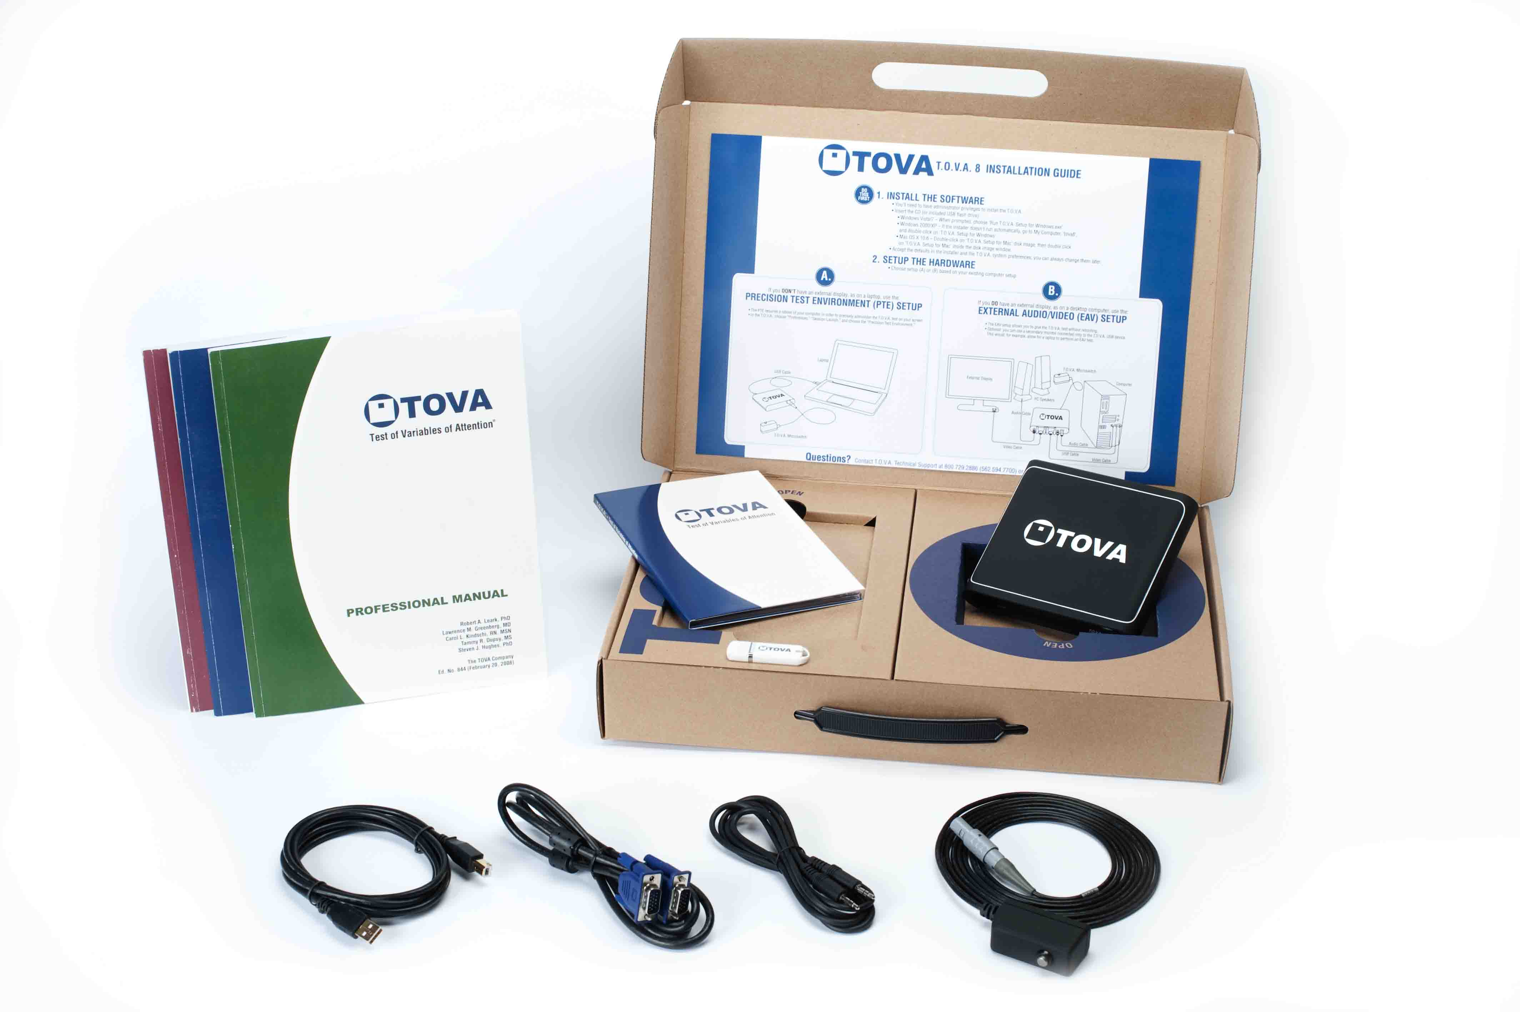

Slide 43
Visual Stimuli: Focus Point
.
Notes:
We’re looking at the focus point of the visual T.O.V.A.- it’s where the target and nontarget are going to appear on the monitor.
________________________________________________________________________________________________________________________________________________________________________________________________________________________________________________________________________________________________________________________________________________________________________________________________________________________________________________________________________________________________________________________________________________________________________________________________________________________________________________________________________________________________________________________________________________________________________________________________

Slide 44
Visual Stimuli: Nontarget
Notes:
Here’s the nontarget- a white square in the center of the monitor with a small black square at the bottom. “At the bottom” are the important words.
________________________________________________________________________________________________________________________________________________________________________________________________________________________________________________________________________________________________________________________________________________________________________________________________________________________________________________________________________________________________________________________________________________________________________________________________________________________________________________________________________________________________________________________________________________________________________________________________

Slide 45
Visual Stimuli: Target
Notes:
Here’s the target- the only difference is that the small black square is on top. The instructions are to press the response button as quickly as you can whenever you see the square on top
________________________________________________________________________________________________________________________________________________________________________________________________________________________________________________________________________________________________________________________________________________________________________________________________________________________________________________________________________________________________________________________________________________________________________________________________________________________________________________________________________________________________________________________________________________________________________________________________

Slide 46
Visual Practice Test
Notes:
Click the image to start the visual practice test movie.

Slide 47
Auditory Stimuli
Target: G above Middle C (392.0 Hz)
Nontarget: Middle C (261.6 Hz)
Notes:
The auditory T.O.V.A.-A. uses two easily discerned tones, and the instructions are to press the button for the higher tone.

Slide 48
Auditory Practice Test
Notes:
Click the speaker to start the auditory practice test clip.

Slide 49
T.O.V.A. Test Construction
Fixed 2 second intervals between stimuli
Stimulus “on” for 1/10 second (100 ms)
There are two subtests
In half 1 (the "Infrequent" or vigilance test) the target-to-nontarget ratio is 1:3.5
In half 2 (the "Frequent" or high response test) the target-to-nontarget ratio is 3.5:1
Length of test
10.8 minutes for each subtest, 21.6 minutes total for 6 and older
Thus 21.6 minutes for entire test
“Sufficiently long” for measuring attention
5.4 minutes each subtest, 10.8 minutes total for ages 4-5,
Notes:
A target or a nontarget appear (or sound) every 2 seconds for 100 ms (1/10 second). The test is 21.6 minutes long- 21.6 very boring minutes long. In the first half, one target occurs for every 3.5 nontargets, randomly. It’s called the “Infrequent” or vigilance task. You have to be watching closely or you’ll miss the occasional target. They make omission errors when they omit pressing the button when they should. Inattentive people and people who need arousing tasks don’t do well. In the second half, 3.5 targets occur to every 1 nontarget, randomly. It’s the reverse of the first half, and is called the “Frequent” or high response task. Now the people who have trouble inhibiting their responses continue to press the response button even when the uncommon nontarget appears. They make commission errors.
Why is the T.O.V.A. so long? Too “catch” adults with ADHD who can “rally” their attention for 10 or 15 minutes.
As we’ll see later, there is a short form of both the T.O.V.A. and the T.O.V.A.-A.
The “IF” form is for 4 and 5 year olds who can’t sit for 21+ minutes. It consists of only two quarters (the Infrequent [target] quarter 1 and the Frequent [target] quarter 3 of the full test). The IF is only normed for 4 and 5 year olds.

Slide 50
T.O.V.A. Test Features I
Research-quality time measurement (±1 ms)
Real time measurement
Notes:
________________________________________________________________________________________________________________________________________________________________________________________________________________________________________________________________________________________________________________________________________________________________________________________________________________________________________________________________________________________________________________________________________________________________________________________________________________________________________________________________________________________________________________________________________________________________________________________________

Slide 51
Timing Accuracy of CPTs
Preset Mean Standard Exact Measured Deviation
Software/ Response Response Measured
Input Device Time Time Response
(ms) (ms) (ms)
T.O.V.A.™ Microswitch 300 300 ±1
600 599 ±1
Conners' with Mouse 300 353 +28
600 655 +14
900 943 +21
Conners' with Keyboard 300 355 +28
600 656 +11
900 948 +25
Notes:
________________________________________________________________________________________________________________________________________________________________________________________________________________________________________________________________________________________________________________________________________________________________________________________________________________________________________________________________________________________________________________________________________________________________________________________________________________________________________________________________________________________________________________________________________________________________________________________________

Slide 52
T.O.V.A. Test Features II
Monochromatic
Nonsequential
Non-alphanumeric
Culture free
Notes:
Other important T.O.V.A. features include:
ｷ Monochromatic stimuli- no flashy colors to stimulate or distract the subject
We wanted the simplest task
ｷ Nonsequential stimuli- you don’t have to remember that you just saw an A when an X appears. Instead it’s a “go/no go” task- it is or it isn’t the target. We didn’t want working memory to be a contributing factor
ｷ Non-language based- it can and is used in any number of countries from China to the US.
ｷ Culture free: two geometric forms or two tones, that’s all.

Slide 53
T.O.V.A. Test Features III
Fixed intervals
Visual or auditory
Limited practice effects (high test-retest reliability)
Extensive age and gender based norms from 4-80+
Symptom Exaggeration Index
Notes:
ｷ The inter-stimulus interval (the time between stimuli) is fixed-
It’s always 2 seconds. In contrast, the ISI changes during the test in some CPTs, like the Conners’, and actually can provide toward task stimulation for the more easily bored subject or can overload others.
ｷ The T.O.V.A. measures both visual and auditory information processing but separately to avoid stimulation; whereas, the IVA (which does use both visual and auditory modes) can confuse some and stimulate others
ｷ The T.O.V.A. has high test-retest reliability- it’s a simple task.
You can retest someone 1 ½ hours later. There may be a transitory increase in Commission Errors, but it’s not highly significant.
ｷ The T.O.V.A.’s extensive age and gender norms are from 4-80+.
Both age and gender are important variables to control for. The other CPTs have very sketchy norms.
ｷ Finally, the T.O.V.A. can help detect when someone is faking bad.
It may come as a surprise, but a percentage of people diagnosed as having and being treated for ADHD, are malingering. As an example, some students will present at the college health service to be treated for ADHD. It’s not hard to pretend to have ADHD, and to complete a behavior rating accordingly.
Some students try to appear to have ADHD when asked to take the T.O.V.A.- they miss a lot of targets, and often make a number of “false” hits of the nontarget. Of course, they don’t know that at their age (and older), that’s not typical for someone with ADHD. But more about that later.

Slide 54
T.O.V.A. Variables I
Response Time Variability
processing time inconsistency
Correct Response Time
processing time
d' or Response Sensitivity
decrement of performance in differentiating signals (targets) from noise (nontargets)
Notes:
The T.O.V.A. variables include:
Response Time Variability- response time consistency, the most important measure of the T.O.V.A. With age, a person’s performance on the T.O.V.A. gets faster and very consistent- the range of response times becomes pretty small. With ADHD, however, the variability is usually significantly higher (that is, wider/ more faster and more slower) than normal.
Correct Response Time- how long does it take to respond to a target. Response Time gets faster with age until the mid- to late teen years, levels off and stays pretty much the same until the late 60s when it starts to slow a bit. Interestingly, there’s some new T.O.V.A. research that shows the Response Time and the Response Time Variability to begin to worsen in the 40s in cases that will later be diagnosed as dementia.
d’ or Response Sensitivity, a measure from Signal Detection Theory, that indicates the rate of
deterioration of performance over time as measured by error rates. The performance of persons with ADHD tends to get worse faster than normals.
________________________________________________________________________________________________________________________________________________________________________________________________________________________________________________________________________________________________________________________________________________________________________________________________________________________________________________________________________________________________________________________________________________________________________________________________________________________________________________________________________________________________________________________________________________________________________________________________

Slide 55
T.O.V.A. Variables II
Errors of Commission
responding incorrectly to a nontarget; a measure of impulsivity and/or disinhibition
Errors of Omission
not responding to a target; a measure of inattention
Notes:
Errors of Commission occur when someone presses the response button when it’s not a target. It’s a measure of impulsivity. Some children have such high numbers of Commission Errors that the rest of the T.O.V.A. variables can be significantly altered; hence, the T.O.V.A. Interpretation Report will caution you to interpret quarters of the test with excessive errors carefully. Like the other variables, errors decrease with age normally.
Errors of Omission occur when someone doesn’t respond to a target- it’s a measure of inattention. These too usually disappear with age unless the person has an attention disorder. As you’ll later, when there are a lot of Omission Errors, we need to consider the possibility of a seizure disorder. Sometimes there is a characteristic finding that would lead us to consider that possibility- when the Omission Errors occur in bunches, rather than scattered. We’ll see some examples later.

Slide 56
T.O.V.A. Variables III
Anticipatory Responses
responding <150 ms after stimulus; a measure of guessing
Post-Commission Response Time
Response Time following a Commission Error; self control measure
Multiple Responses
more than one response per stimulus; a reflection of neurological status and/or test taking behavior
Commission Error Response Time
Response time when making a commission error
Notes:
Anticipatory Responses occur when someone responds in less than 150 ms after the stimulus. It’s a measure of guessing; however, you have to be careful in interpreting them because some people, especially computer game devotees, musicians (like drummers), and some athletes are much faster than most people. Whenever the number of Anticipatories equals or exceeds 10% in a quarter, the T.O.V.A. Report will caution you to examine the ratio of nontarget hits to target hits to determine whether the person was really very fast or the quarter is invalid.
Post-Commission Response Time is the time a person took to correctly respond to a target following a commission error. Did they notice the error and try to compensate by slowing down? People with and without ADHD do usually slow down although very impulsive people don’t, especially kids with a conduct disorder.
Multiple Responses occur when someone presses the response button more than once a stimulus. Excessive multiples may reflect neurological problems other than ADHD.
________________________________________________________________________________________________________________________________________________________________________________________________________________________________________________________________________________________________________________________________________________________________________________________________________________________________________________________________________________________________________________________________________________________________________________________________________________________________________________________________________________________________________________________________________________________________________________________________

Slide 57
Norms
Variability (SD, ms): Total Test – Females
[Mean + SD]
Standard Deviation of Response Time (ms)
Age
Notes:
Here’s one graphic representation of the norms. This is Response Time Variability (consistency of response times) on the vertical axis, and age on the horizontal axis for females. The higher on the vertical axis, the more inconsistency. What we see is true for most of the T.O.V.A. variables vs age although the curves are somewhat different. People get more consistent (less inconsistent) from 6 to the mid-teen years, level off and stay pretty much the same until the late 60s when they get a bit more inconsistent.
________________________________________________________________________________________________________________________________________________________________________________________________________________________________________________________________________________________________________________________________________________________________________________________________________________________________________________________________________________________________________________________________________________________________________________________________________________________________________________________________________________________________________________________________________________________________________________________________

Slide 58
The T.O.V.A. does not diagnose ADHD
Notes:
Let’s be very clear- the T.O.V.A. doesn’t diagnose ADHD. Clinicians do, hopefully with the help of the T.O.V.A.
________________________________________________________________________________________________________________________________________________________________________________________________________________________________________________________________________________________________________________________________________________________________________________________________________________________________________________________________________________________________________________________________________________________________________________________________________________________________________________________________________________________________________________________________________________________________________________________________

Slide 59
The T.O.V.A. measures attention, impulsivity, reaction time and consistency.
Notes:
The T.O.V.A. only measures attention and impulsivity- objectively and reliably. The clinician uses these measurements along with other information from the diagnostic assessment to make a diagnosis and monitor treatment.
________________________________________________________________________________________________________________________________________________________________________________________________________________________________________________________________________________________________________________________________________________________________________________________________________________________________________________________________________________________________________________________________________________________________________________________________________________________________________________________________________________________________________________________________________________________________________________________________

Slide 60
Uses of the T.O.V.A. I
Screen children and adults for attention problems
Establish baseline for tracking attention problems over time
Notes:
The T.O.V.A. is used to:
Screen for problems of inattention and impulsivity in non-clinical settings like schools to help determine whether the student should be referred for a clinical evaluation. Since entering school children are routinely screened for visual and hearing problems, why aren’t they also screened for attention disorders that are more common?

Slide 61
Uses of the T.O.V.A. IV
Monitor treatment
Notes:
Uses VII
Monitor treatment and the course of ADHD over time- Medications as well as other treatments for ADHD.
Attention disorders vary with age, and some individuals improve sufficiently to no longer need treatment.
In general, dosage increases from earlier to later childhood, levels off in the early teen years, decreases into the early 20’s, and, assuming that the person does not “normalize”, stays steady until the late 60s when it often decreases somewhat more

Slide 62
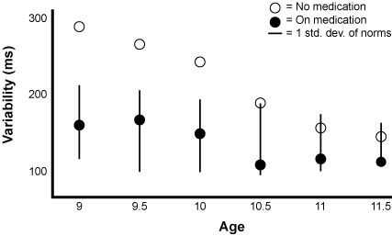
Monitoring Treatment Over Time (Illustration 1)
Notes:
Here’s a treatment summary for a 9 year old girl. At 9, her Response Time Variability without medication (open circle at left) was about 300 ms although normal for her age would have been between 110 and 210 ms (the horizontal line).
On medication (the black circle), her Response Time Variability improved to 160 ms, right in the middle of normal. Nice response.
She was seen every six months and given two T.O.V.A.s, one before and one 1.5 hours after taking her medication. At 9½, her baseline (no medication) performance is actually better but still not in the normal range although her on-medication T.O.V.A. was.
At age 10 she’s better, and by 10½ her baseline performance is within normal range. Great! She was taken off medication although she was seen twice more, and, as part of the research design, was given one dose of medication during both sessions. The results- what you’d expect to see in someone without ADHD- attention improved somewhat with a low dose of medication, but was within normal limits to begin with. And her behavior ratings were also within normal range.
________________________________________________________________________________________________________________________________________________________________________________________________________________________________________________________________________________________________________________________________________________________________________________________________________________________________________________________________________________________________________________________________________________________________________________________________________________________________________________________________________________________________________________________________________________________________________________________________

Slide 63
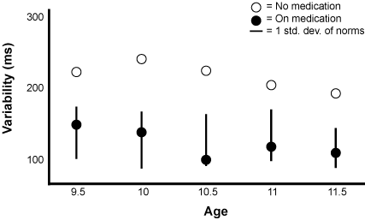
Monitoring Treatment Over Time (Illustration 2)
Notes:
Here’s a treatment summary of a 9½ year old girl who got somewhat better over the years but continued to still need medication when she was 11½.
Will she “outgrow” her ADHD? It’s too early to tell. Some do so in early puberty. Some in the mid-teen years. Fewer in the late teens and early 20s. 50% of children with ADHD go through life with ADHD although the hyperactivity component generally does not persist into the adult years- but the impulsivity can.
Now let’s turn to the T.O.V.A.
________________________________________________________________________________________________________________________________________________________________________________________________________________________________________________________________________________________________________________________________________________________________________________________________________________________________________________________________________________________________________________________________________________________________________________________________________________________________________________________________________________________________________________________________________________________________________________________________

Slide 64
Uses of the TOVA V
Measure effectiveness of medication throughout the day

Slide 65
Test Information
Required Information
Group ID, Subject ID and Session # (automatically generated)
Date and Time of Test (automatically entered)
Date of Birth
Gender
Medication and dosage information
Custom Subject Fields
Optional Information
Subject name
Test administrator’s name
Comments
Notes:
The required information that needs to be entered in the program prior to testing includes:
ｷ Group ID, Subject ID and session #- all are automatically generated by the program
ｷ Date and Time of Test- also automatically generated by the program
ｷ Date of Birth (Once that’s entered, age is automatically generated)
ｷ Gender
ｷ Medication, dosage, and administration-testing interval
Use the “challenge” medication space only if testing with a challenge dose of medication. If you type in “none”, the program will assume that a medication called “none” was given, and the report that will be generated will contain that information. You may type in other medications that the subject is taking for other medical conditions in the other two medication lines or in Comments.
Optional information includes:
ｷ Subject’s name
ｷ Test administrator’s name
ｷ Height and weight
ｷ Comments
________________________________________________________________________________________________________________________________________________________________________________________________________________________________________________________________________________________________________________________________________________________________________________________________________________________________________________________________________________________________________________________________________________________________________________________________________________________________________________________________________________________________________________________________________________________________________________________________

Slide 66
Guidelines for T.O.V.A. Administration
Administered first and only in the mornings
Notes:
It’s important to follow the T.O.V.A. administration guidelines to insure that the norms apply.
First and foremost, the T.O.V.A. is administered first (before other tests) and in the morning like the norms. We don’t have afternoon norms, and do not know enough about diurnal variations.
However, if you are testing for both a baseline (no medication) and an on-medication in the afternoon, you can compare the two tests even though you can’t use the norms.
________________________________________________________________________________________________________________________________________________________________________________________________________________________________________________________________________________________________________________________________________________________________________________________________________________________________________________________________________________________________________________________________________________________________________________________________________________________________________________________________________________________________________________________________________________________________________________________________

Slide 67
Guidelines for T.O.V.A. Administration II
Testing room should be quiet with no distracting noises and with dim lights
An observer must be present at all times
When testing for first time, the entire practice test should be given
Do not prompt unless absolutely necessary
Notes:
The testing room should be quiet, lights dim, and nothing in the subject’s visual field except the monitor (and computer).
An observer must be present. All the norms were obtained with a non-interacting observer present during the testing because preliminary data showed that many children did worse when there was no observer present
A complete practice test (3½ minutes) should precede the first T.O.V.A.
Thereafter, a brief practice can be used to be sure the subject remembers the test. Prompting during the practice is fine.
Do not prompt during the actual test unless absolutely necessary and record it.
________________________________________________________________________________________________________________________________________________________________________________________________________________________________________________________________________________________________________________________________________________________________________________________________________________________________________________________________________________________________________________________________________________________________________________________________________________________________________________________________________________________________________________________________________________________________________________________________

Slide 68
Guidelines for T.O.V.A. Administration III
Use the T.O.V.A. Rating Form
Notes:
Use the T.O.V.A. Rating Form to record observations, etc., during testing.
________________________________________________________________________________________________________________________________________________________________________________________________________________________________________________________________________________________________________________________________________________________________________________________________________________________________________________________________________________________________________________________________________________________________________________________________________________________________________________________________________________________________________________________________________________________________________________________________

Slide 69
Notes:
It’s easy enough to use, and is especially helpful when someone else, other than the clinician, is doing the testing. It’s an easy way to communicate observations during testing. You’ll note that the behaviors can be rated quarter by quarter

Slide 70
Guidelines for T.O.V.A. Administration IV
Record use of caffeinated beverages and nicotine
Record sleep in the night before testing
Notes:
Do record the use of caffeinated beverages and nicotine. Don’t forget soda (or “pop”).
________________________________________________________________________________________________________________________________________________________________________________________________________________________________________________________________________________________________________________________________________________________________________________________________________________________________________________________________________________________________________________________________________________________________________________________________________________________________________________________________________________________________________________________________________________________________________________________________

Slide 71
Guidelines for T.O.V.A. Administration V
Allow 1.5 hours of rest between T.O.V.A. tests.
Notes:
If doing two T.O.V.As (like the T.O.V.A. and the T.O.V.A.-A.) the same morning, allow a 1½ rest in between the two tests.
A 1.5 hour interval is sufficient for doing a challenge medication test the same day as a baseline if the medication is a short acting form. For long acting forms, you should allow an interval of 2.5-3 hours.
________________________________________________________________________________________________________________________________________________________________________________________________________________________________________________________________________________________________________________________________________________________________________________________________________________________________________________________________________________________________________________________________________________________________________________________________________________________________________________________________________________________________________________________________________________________________________________________________

Slide 72
GUIDELINES FOR T.O.V.A. ADMINISTRATION 6
Compare Visual and Auditory T.O.V.A.’s for a more comprehensive assessment.
Notes:
A person’s auditory and visual processing may be different.

Slide 73
T.O.V.A. Interpretation
Clinical reports use clinical wording:
The results are within normal limits.
Overall, this T.O.V.A. is suggestive of an attention problem.
Screening reports avoid any diagnostic statement that could become a liability problem for non-clinicians, non-mental health professionals, and schools using the T.O.V.A.:
The results are within normal limits.
The results are not within normal limits and warrant a referral to a clinician for a clinical assessment.

Slide 74
T.O.V.A. Interpretation
THE T.O.V.A. DOES NOT DIAGNOSE ADHD:
“Suggestive of an attention problem” does not necessarily mean that the person has ADHD.
It simply means that the results were not within normal limits for age, gender, and assuming average intelligence.
The T.O.V.A. Interpretation and the Attention Performance Index (API) are two separate interpretations of the data
These test results are not within normal limits, and the API (-2.18) is also not within normal limits.
An API "within normal limits" is considered "inconclusive”. The subject may have an attention problem (including ADHD) but does not have the typical ADHD pattern.

Slide 75
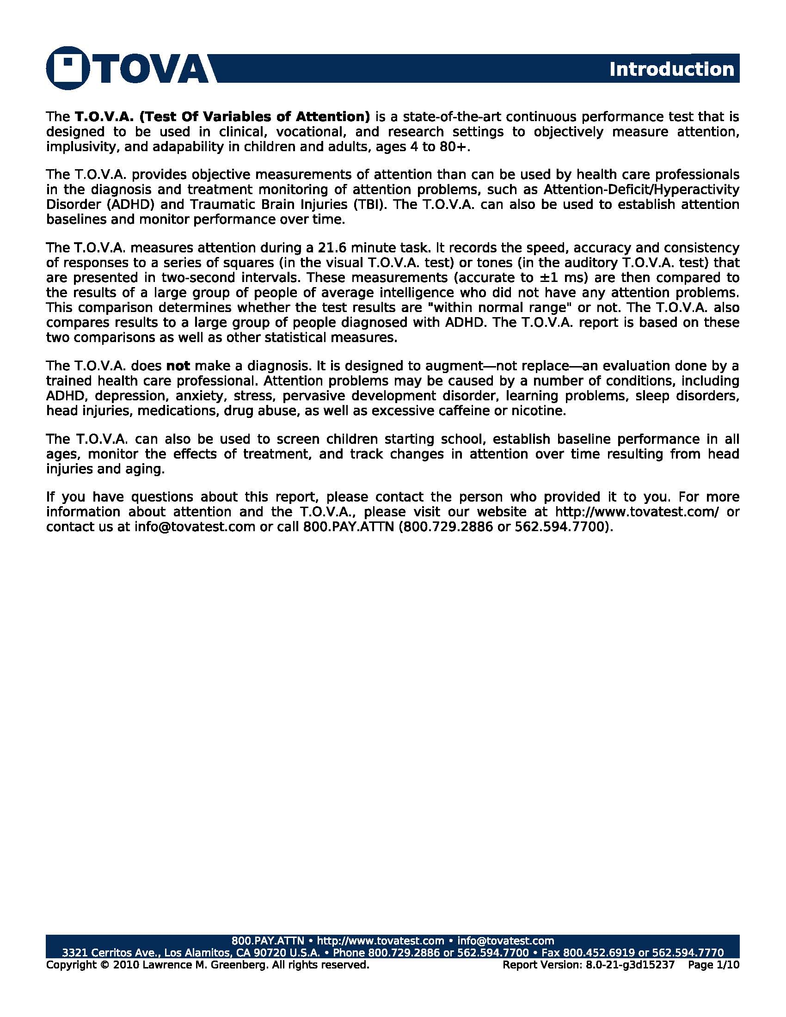
This page is included in a Standard T.O.V.A. Report and in the Detailed T.O.V.A. Report
Notes:
This page is included in a Standard T.O.V.A. Report and in the Detailed T.O.V.A. Report

Slide 76
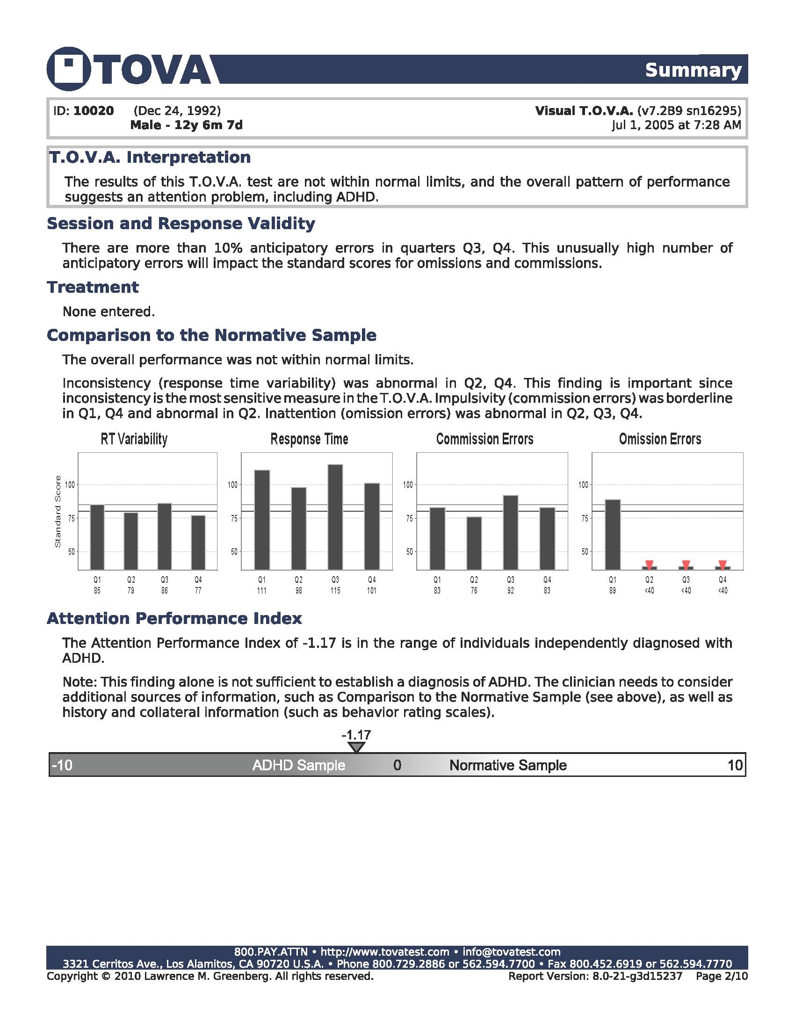
This page is included in a Standard T.O.V.A. Report and in the Detailed T.O.V.A. Report
Notes:
This page is included in a Standard T.O.V.A. Report and in the Detailed T.O.V.A. Report

Slide 77
This page is included in a Standard T.O.V.A. Report and in the Detailed T.O.V.A. Report
Notes:
This page is included in a Standard T.O.V.A. Report and in the Detailed T.O.V.A. Report

Slide 78
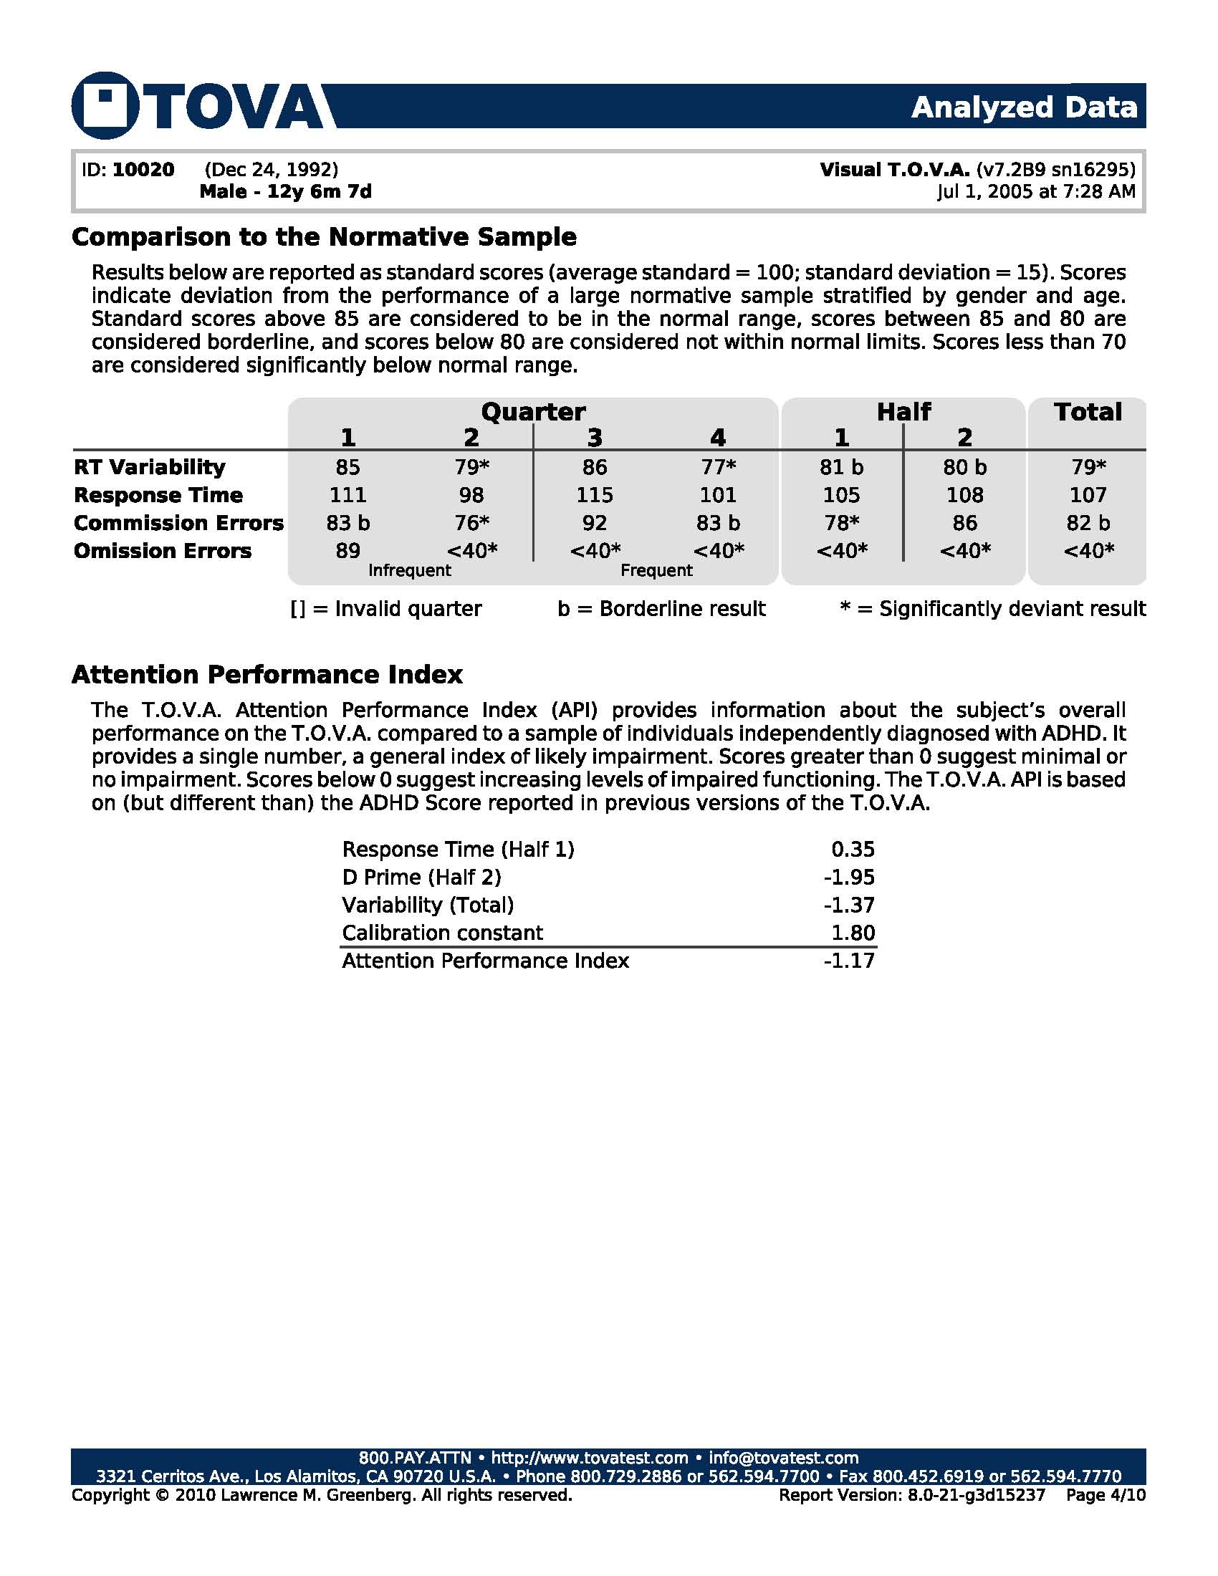
This page is included in a Standard T.O.V.A. Report and in the Detailed T.O.V.A. Report
Notes:
This page is included in a Standard T.O.V.A. Report and in the Detailed T.O.V.A. Report

Slide 79
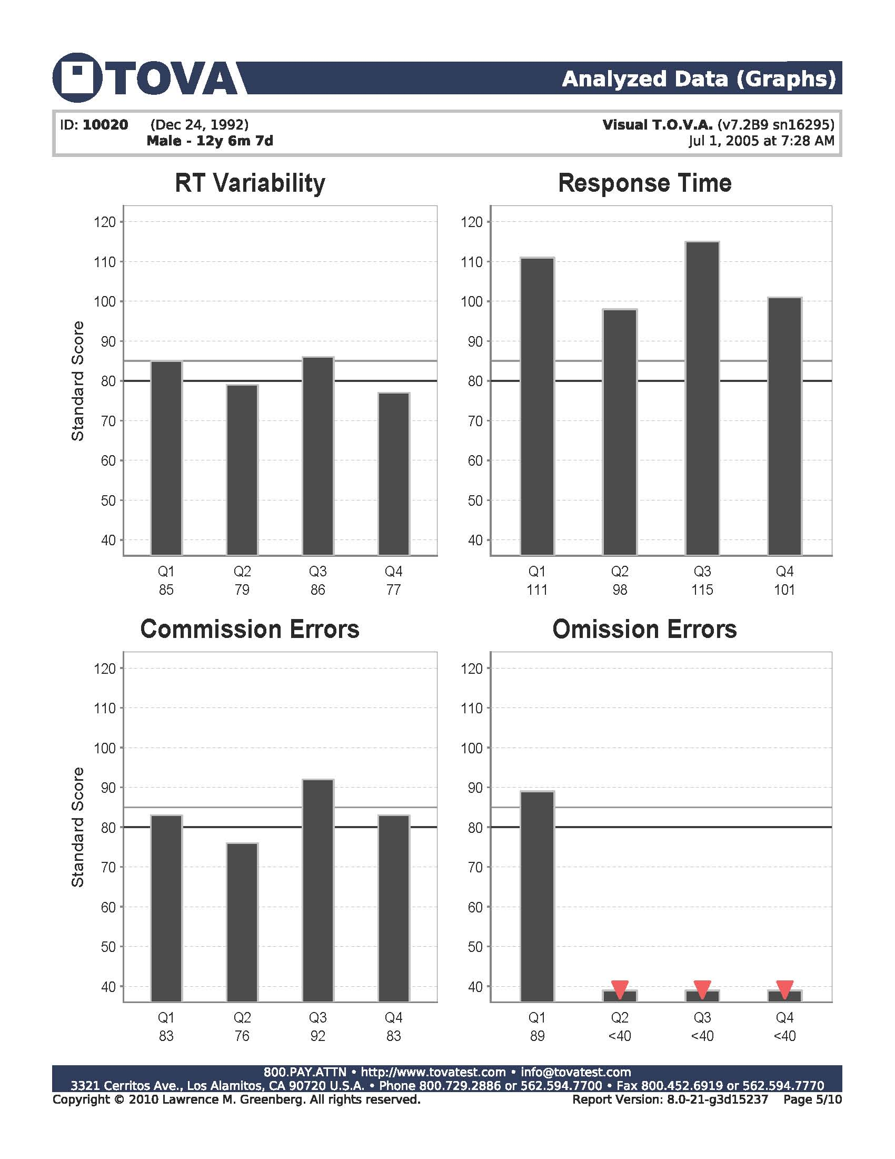
Notes:
This page is an optional page NOT included in the Standard or Detailed T.O.V.A. report. It can easily be added by clicking on a little tool.

Slide 80
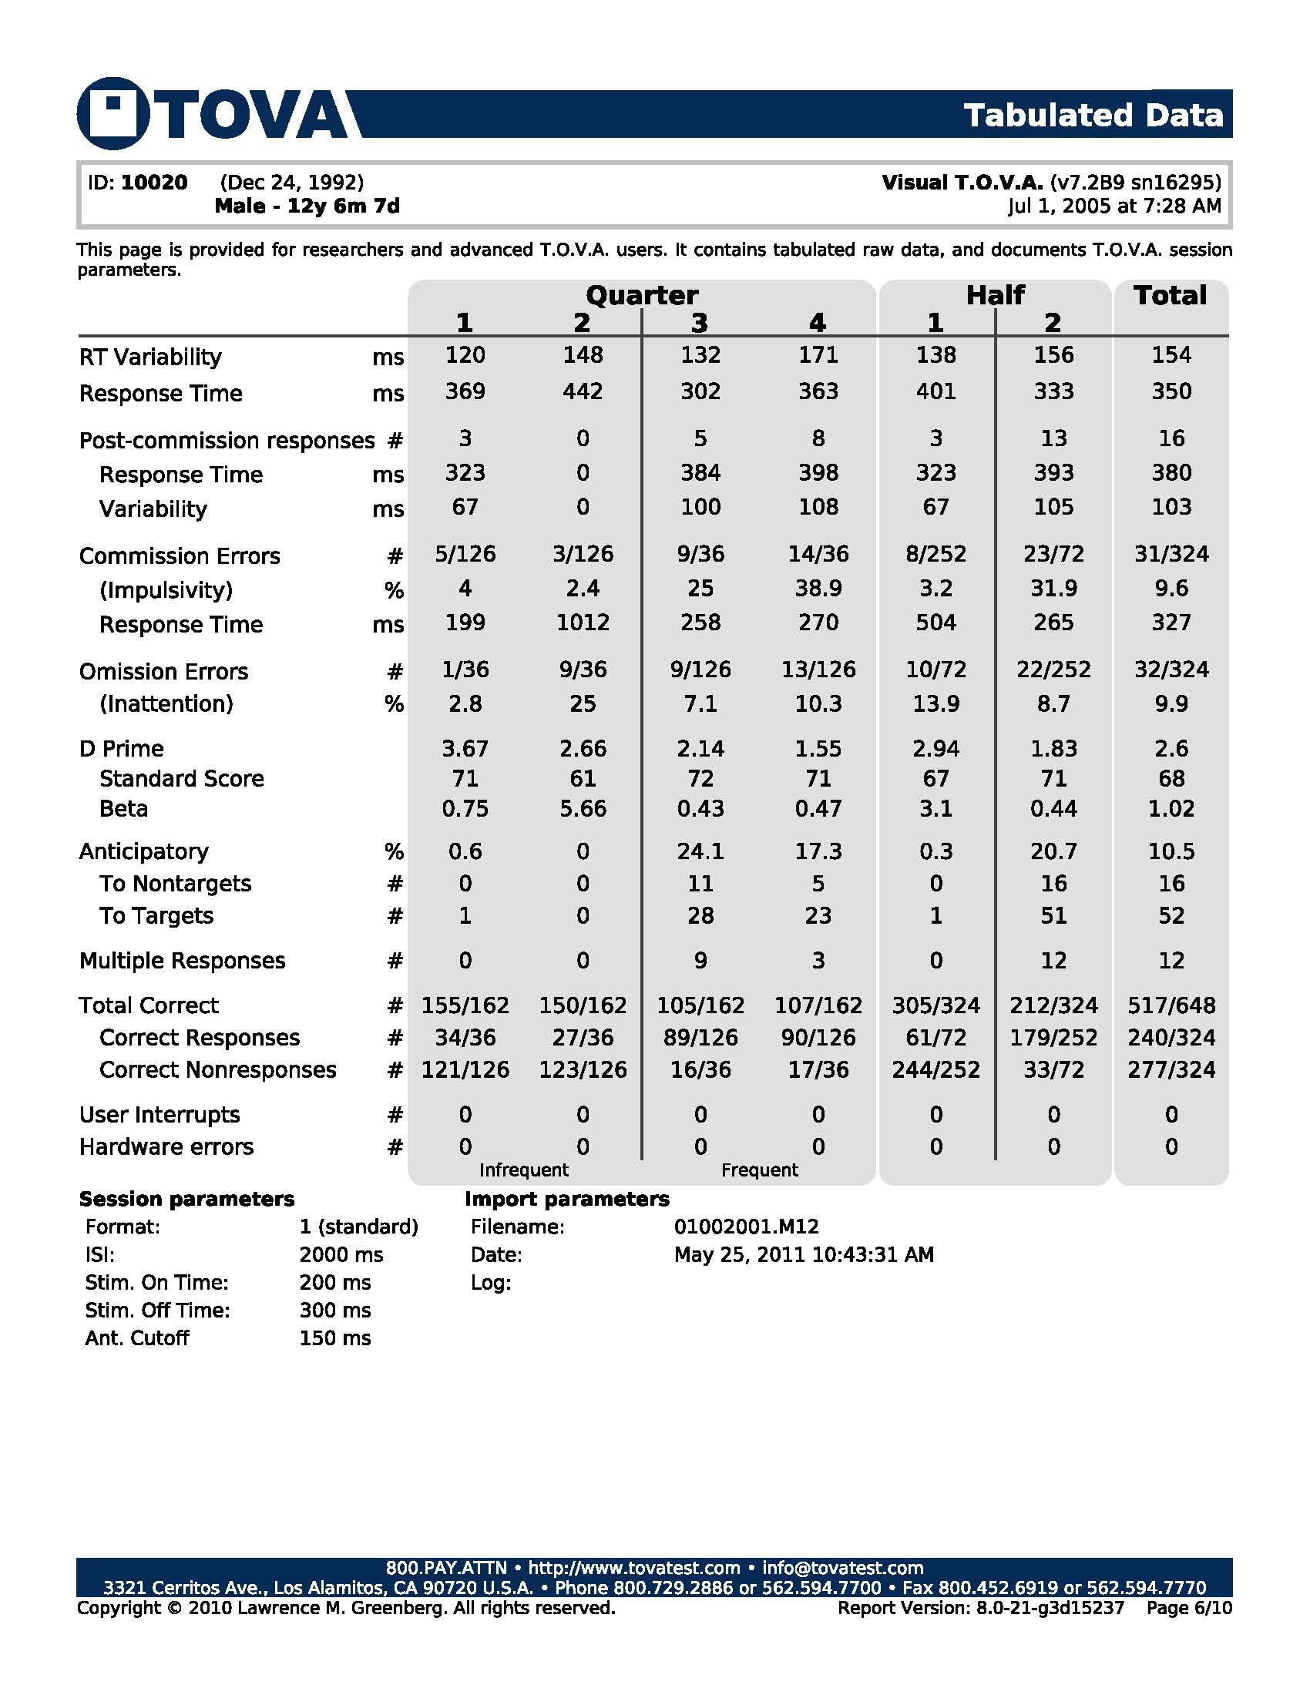
This page is included in a Standard T.O.V.A. Report and in the Detailed T.O.V.A. Report
Notes:
This page is included in a Standard T.O.V.A. Report and in the Detailed T.O.V.A. Report

Slide 81
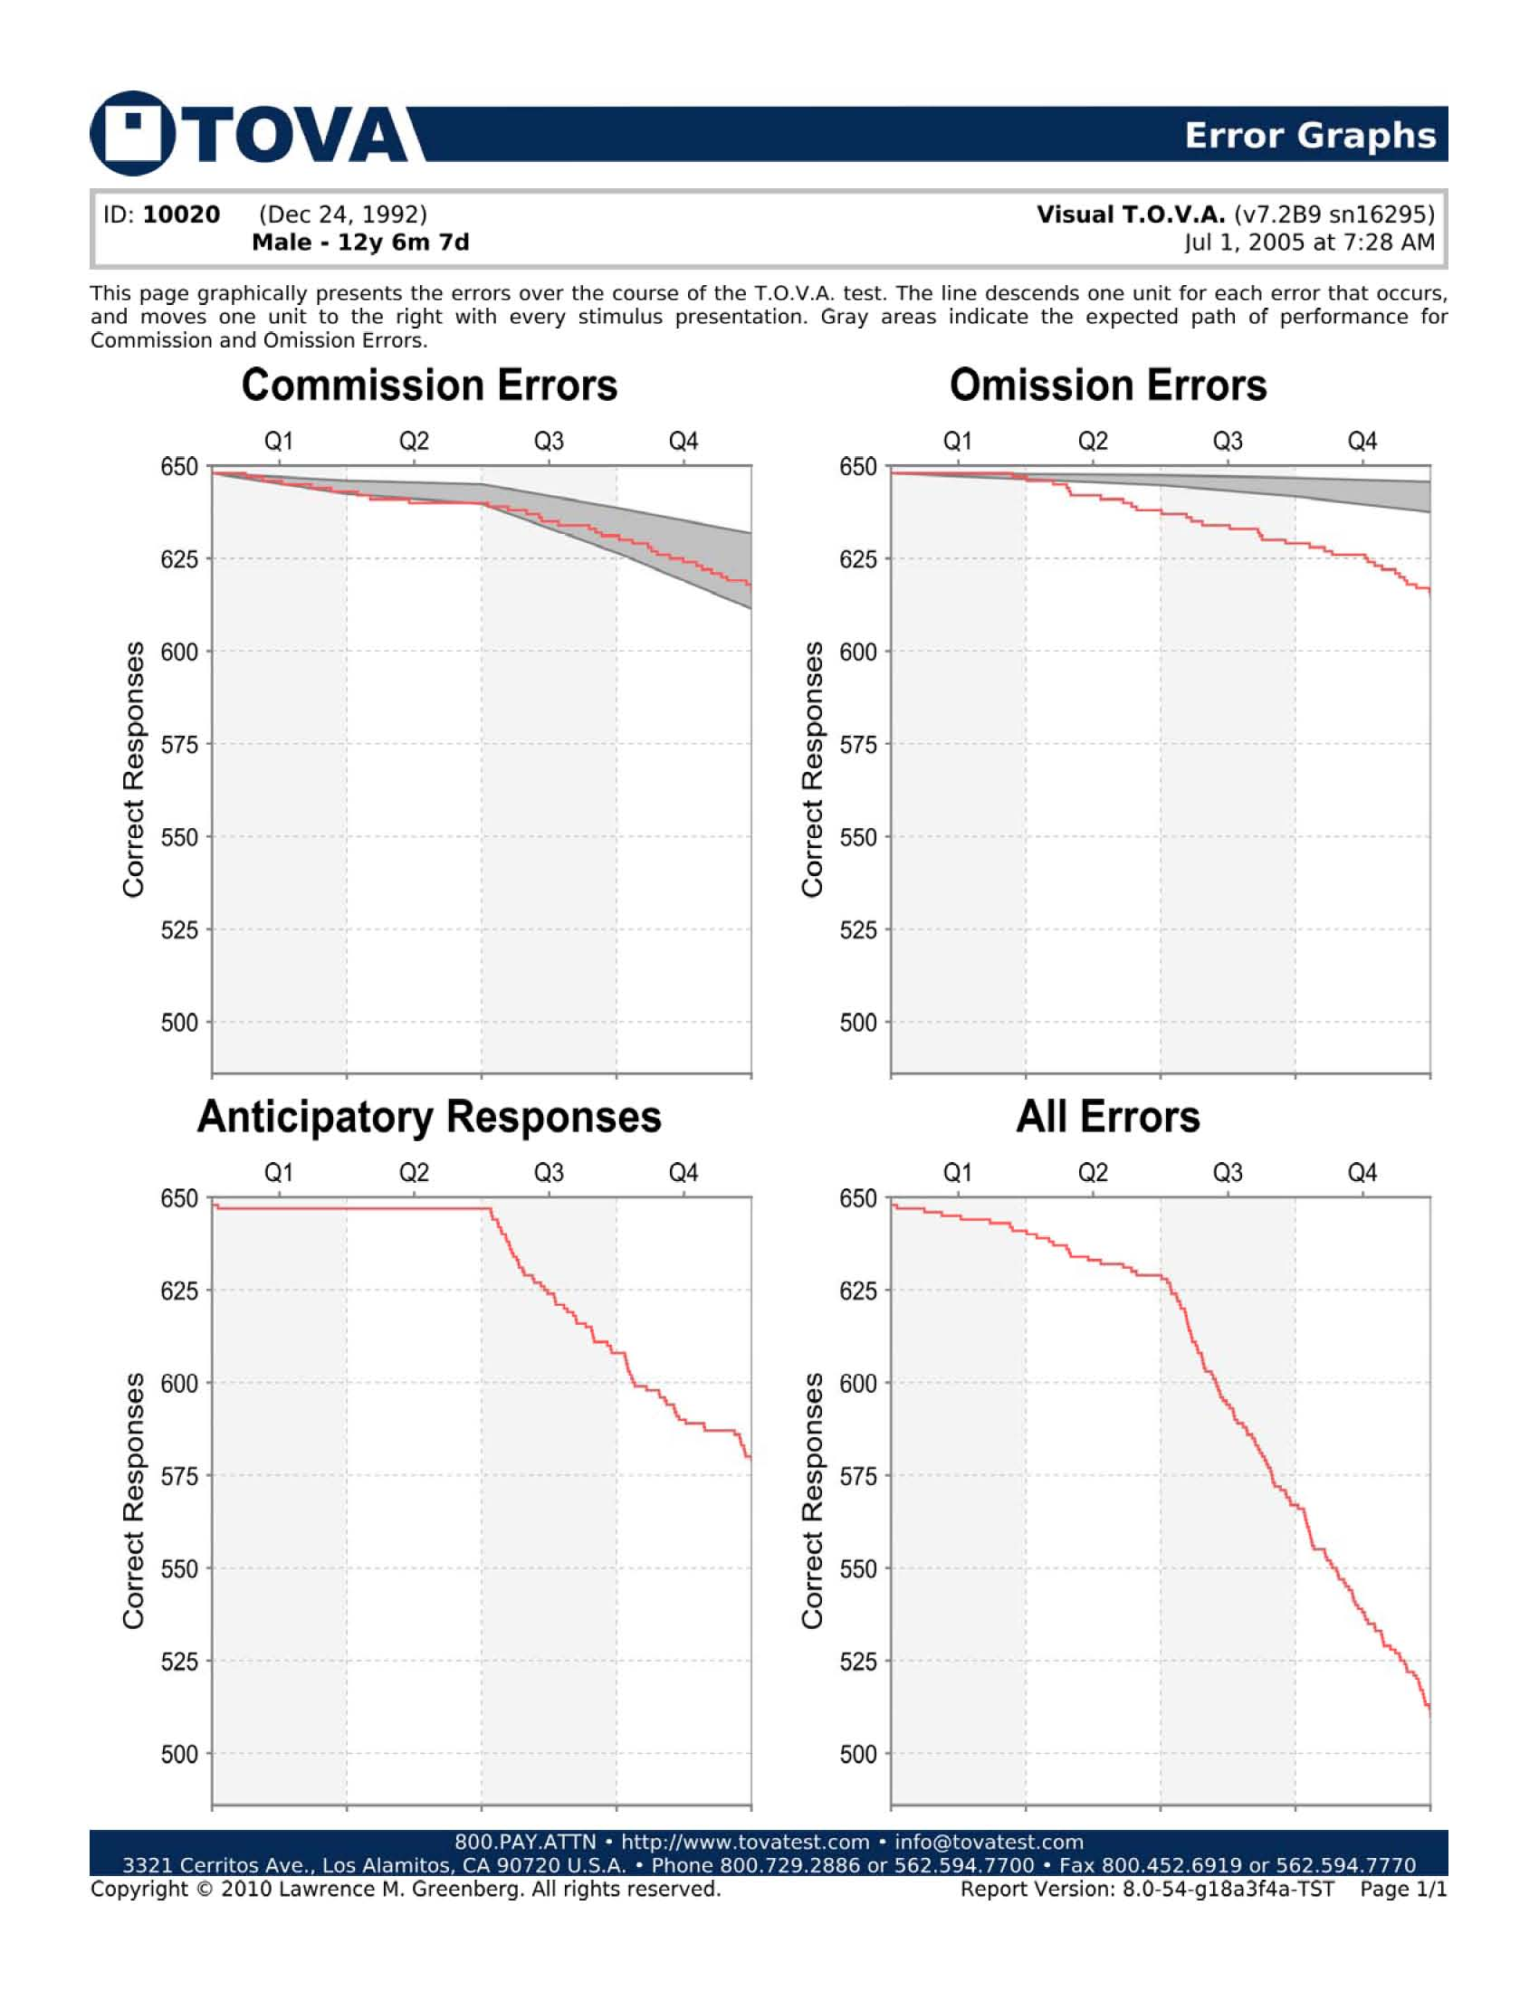
This page is included in the Detailed T.O.V.A. Report

Slide 82
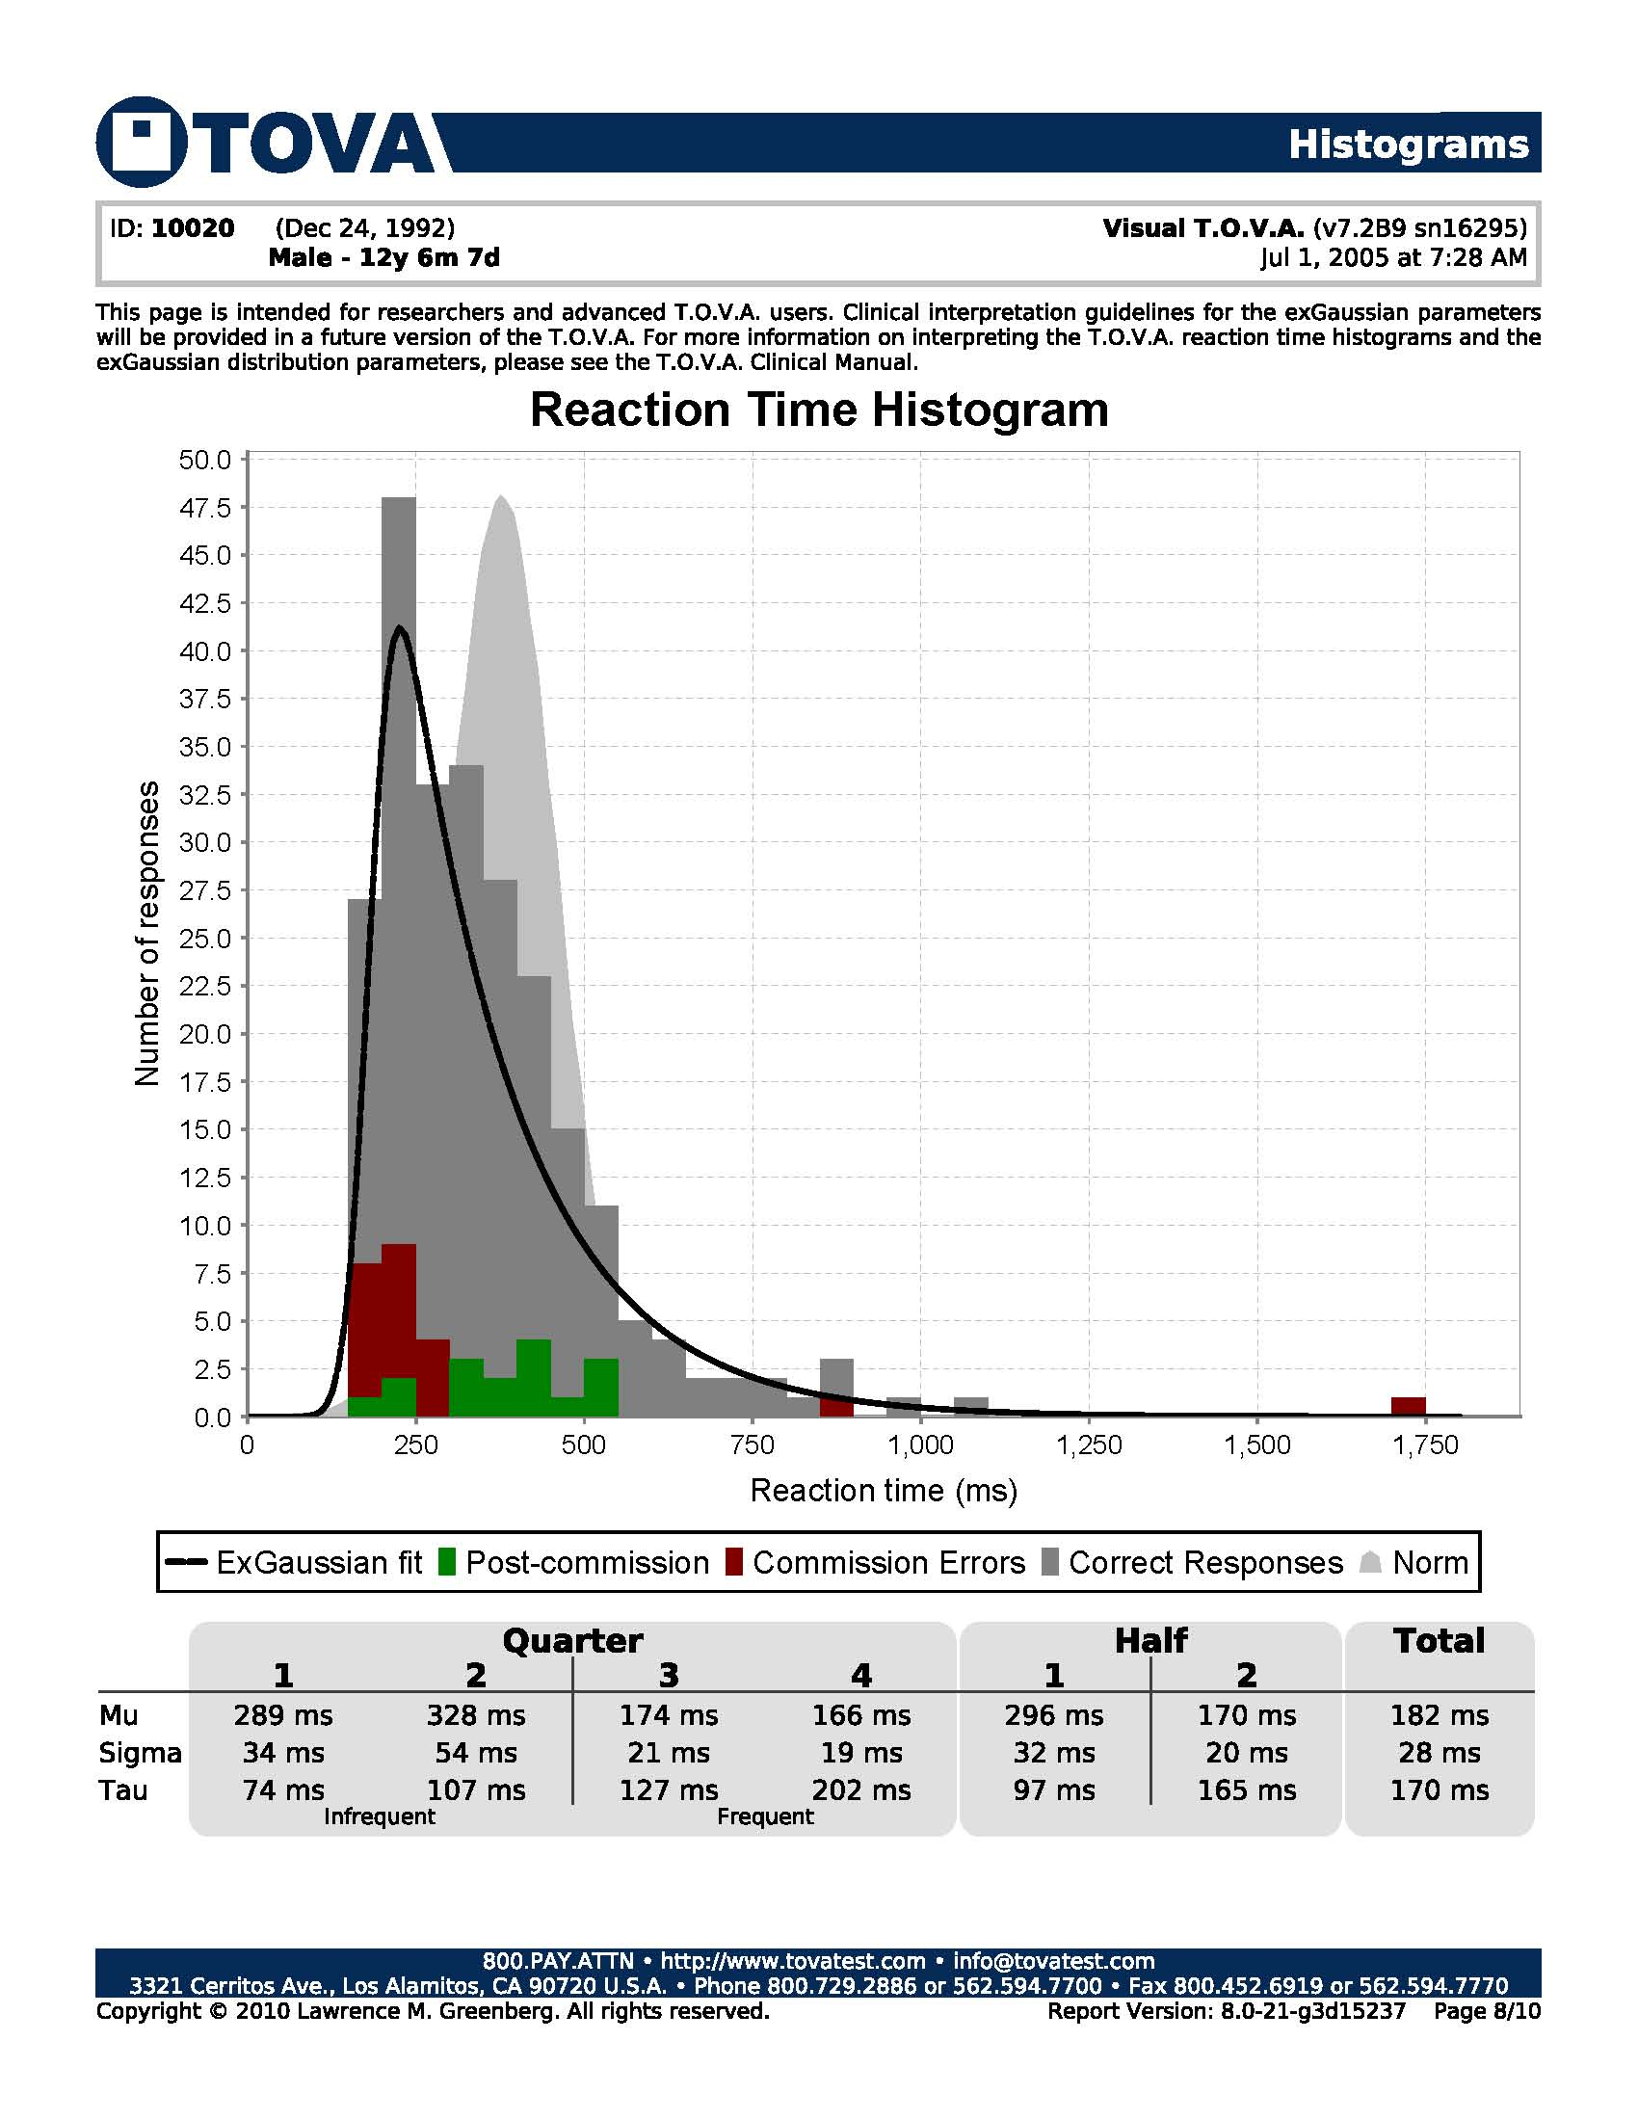
This page is included in the Detailed T.O.V.A. Report

Slide 83
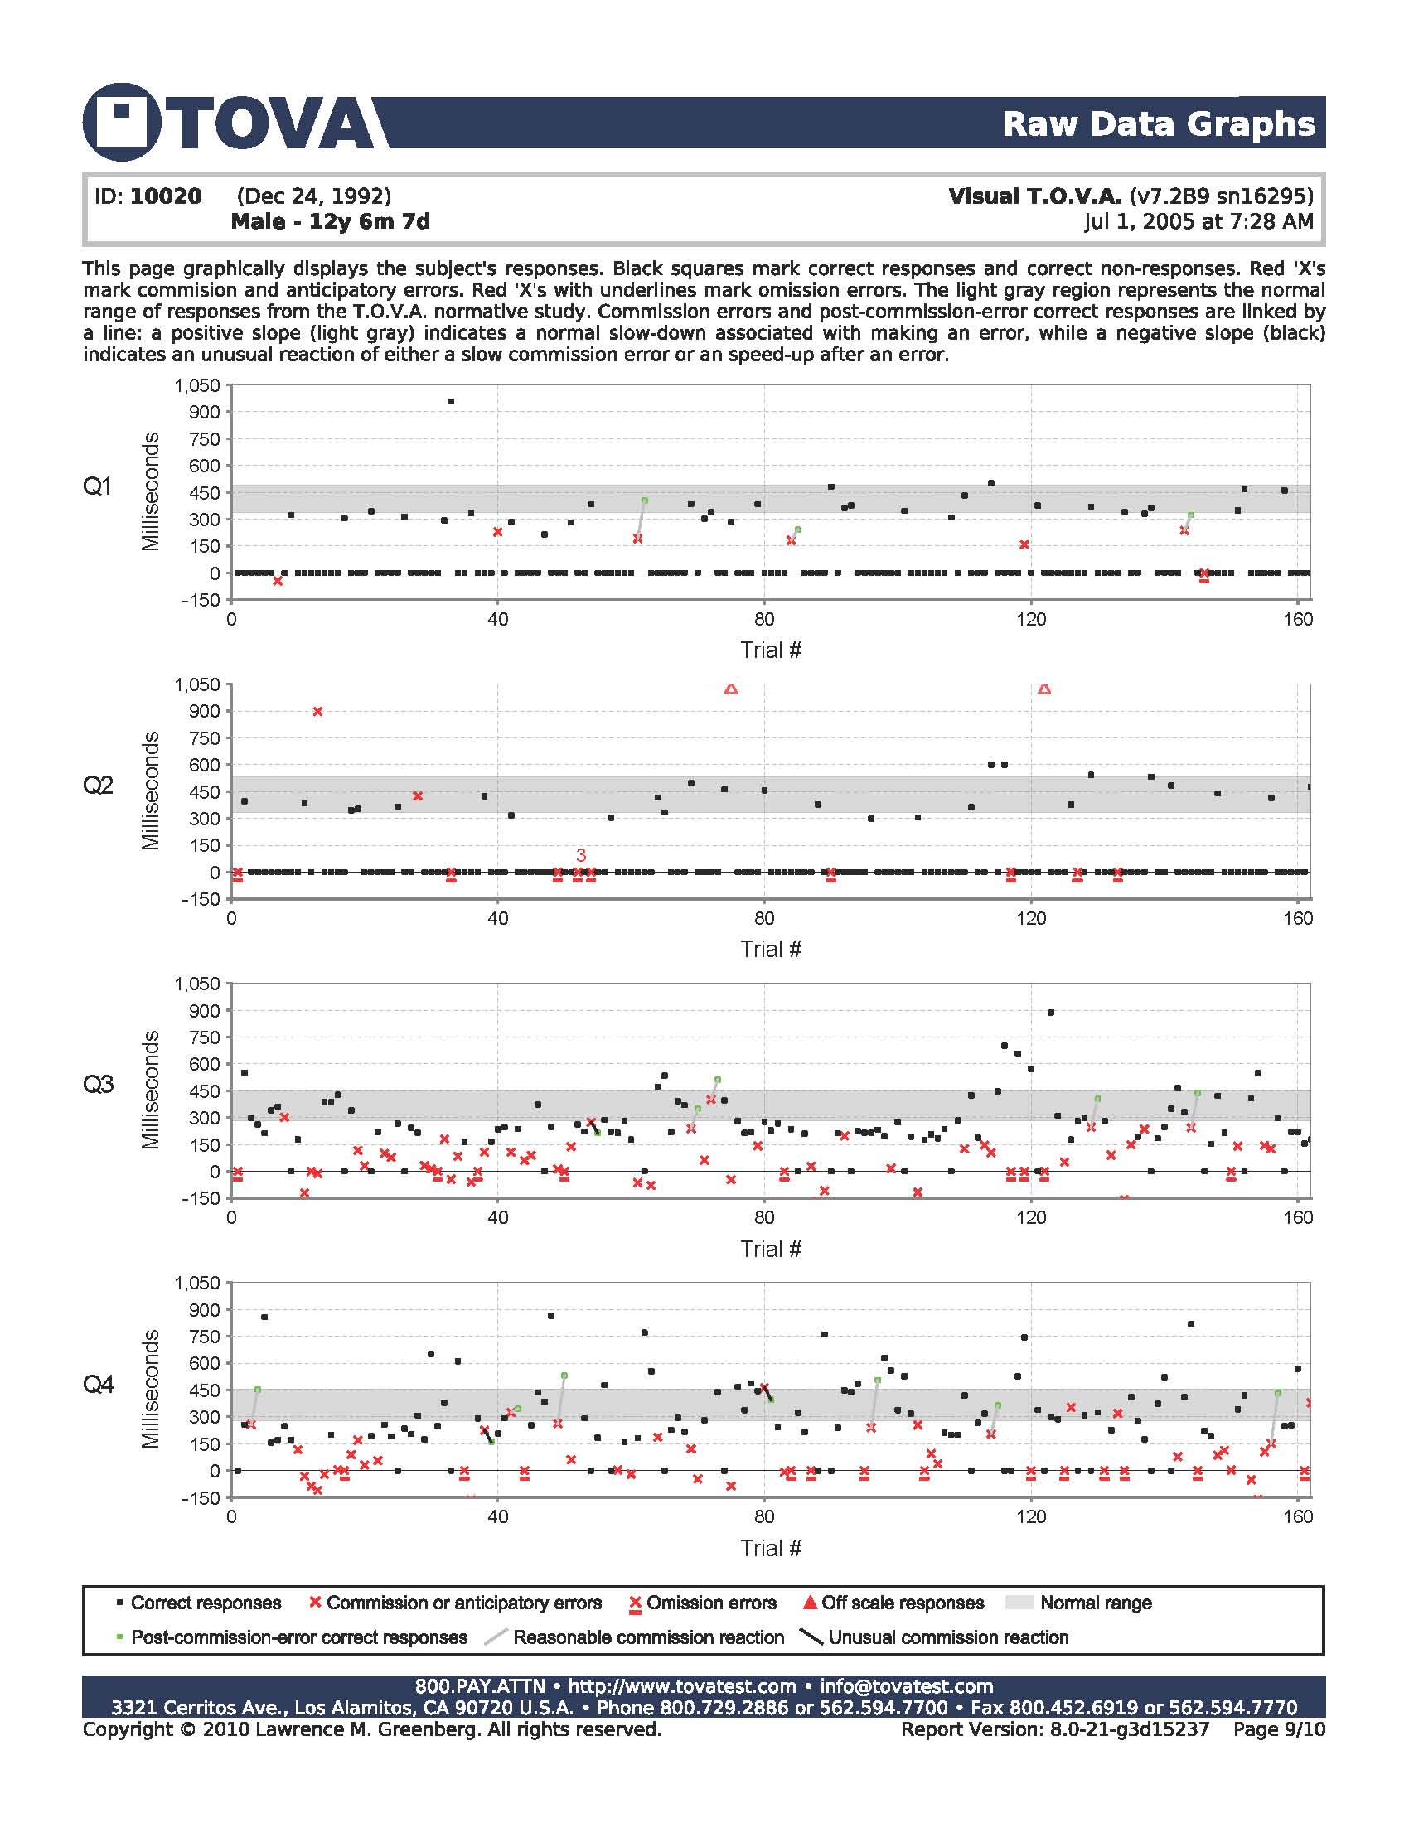
This page is included in a Standard T.O.V.A. Report and in the Detailed T.O.V.A. Report

Slide 84
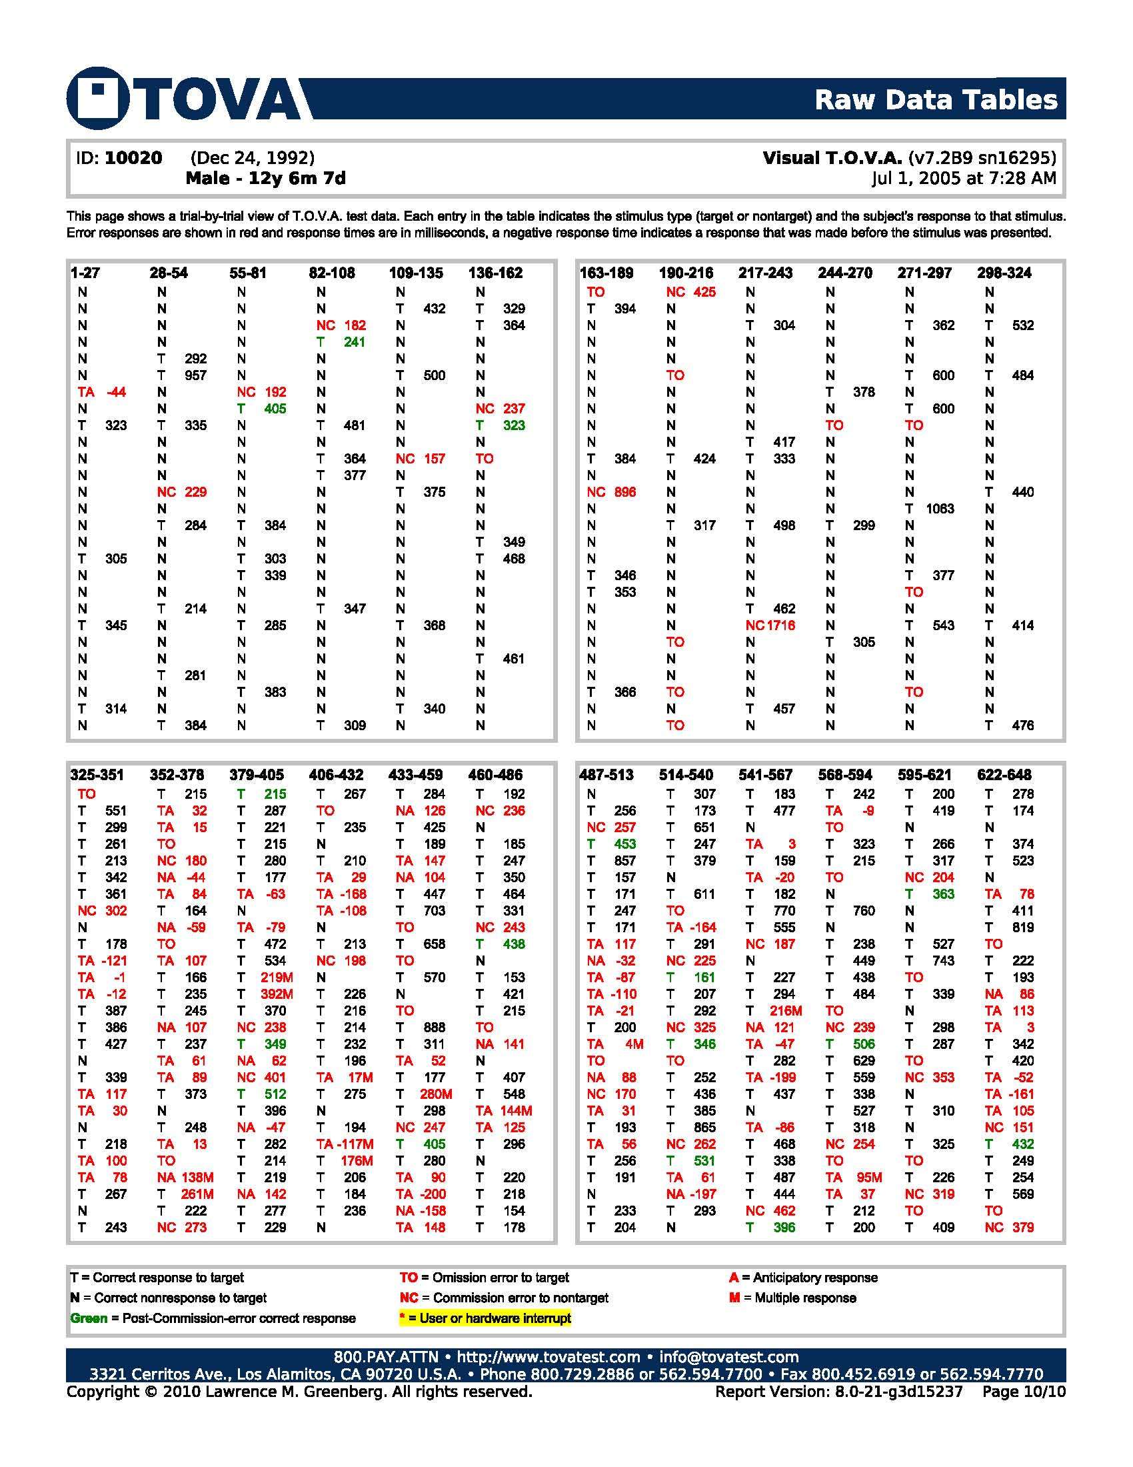
Notes:
This page is an optional page NOT included in the Standard or Detailed T.O.V.A. report. It can easily be added by clicking on a little tool.

Slide 86
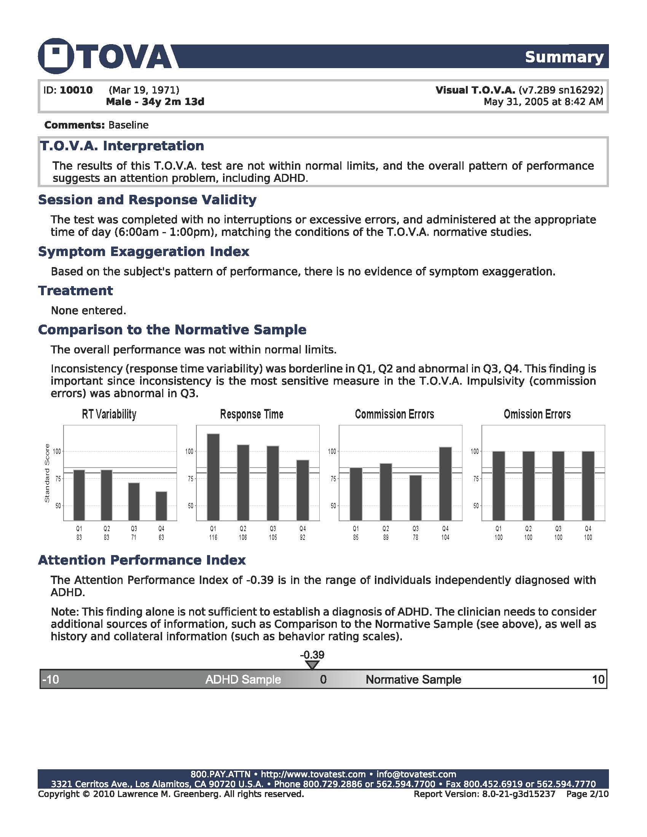

Slide 87
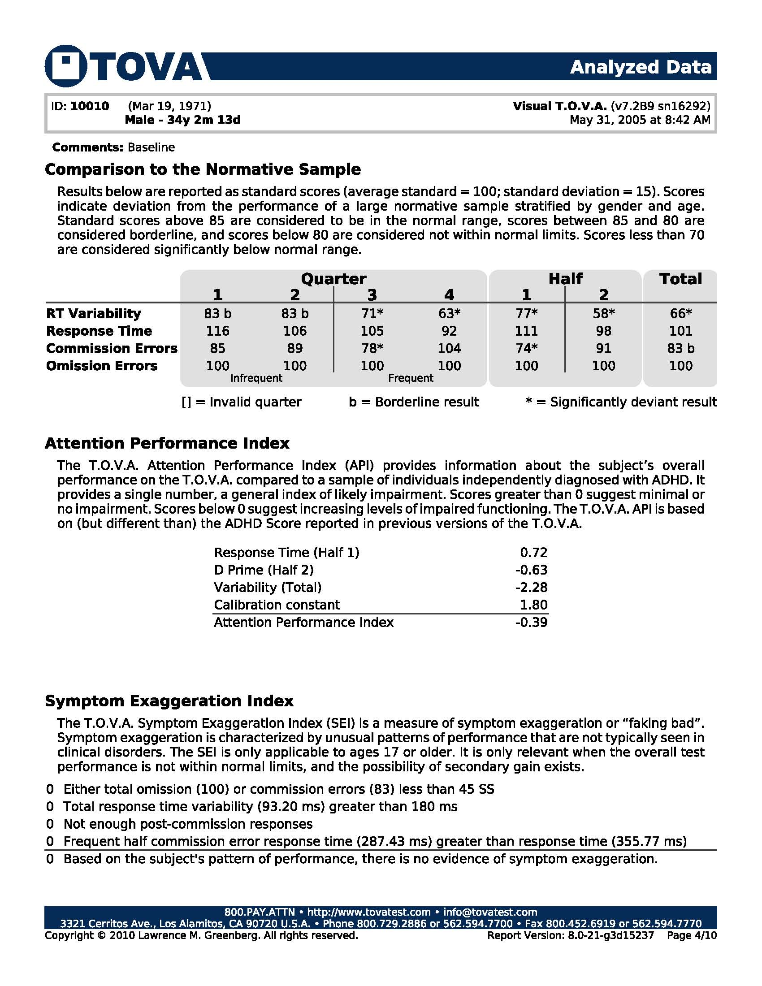

Slide 88
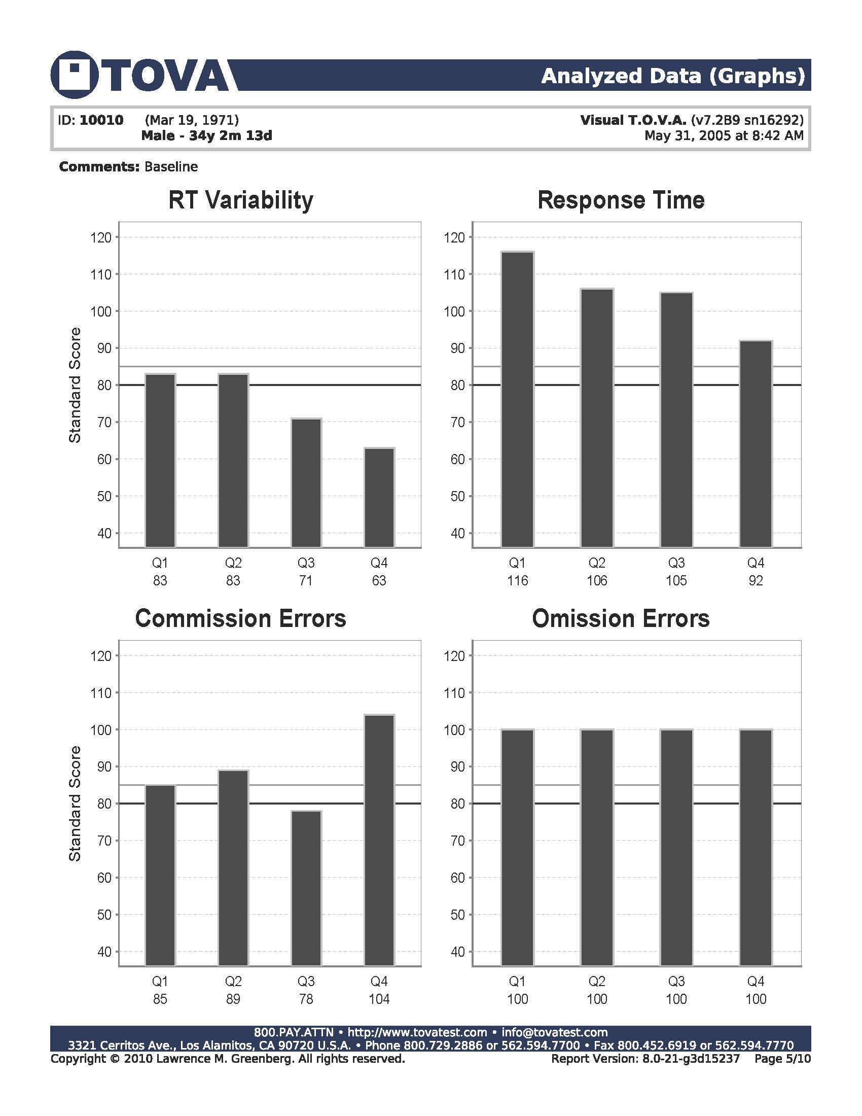

Slide 89
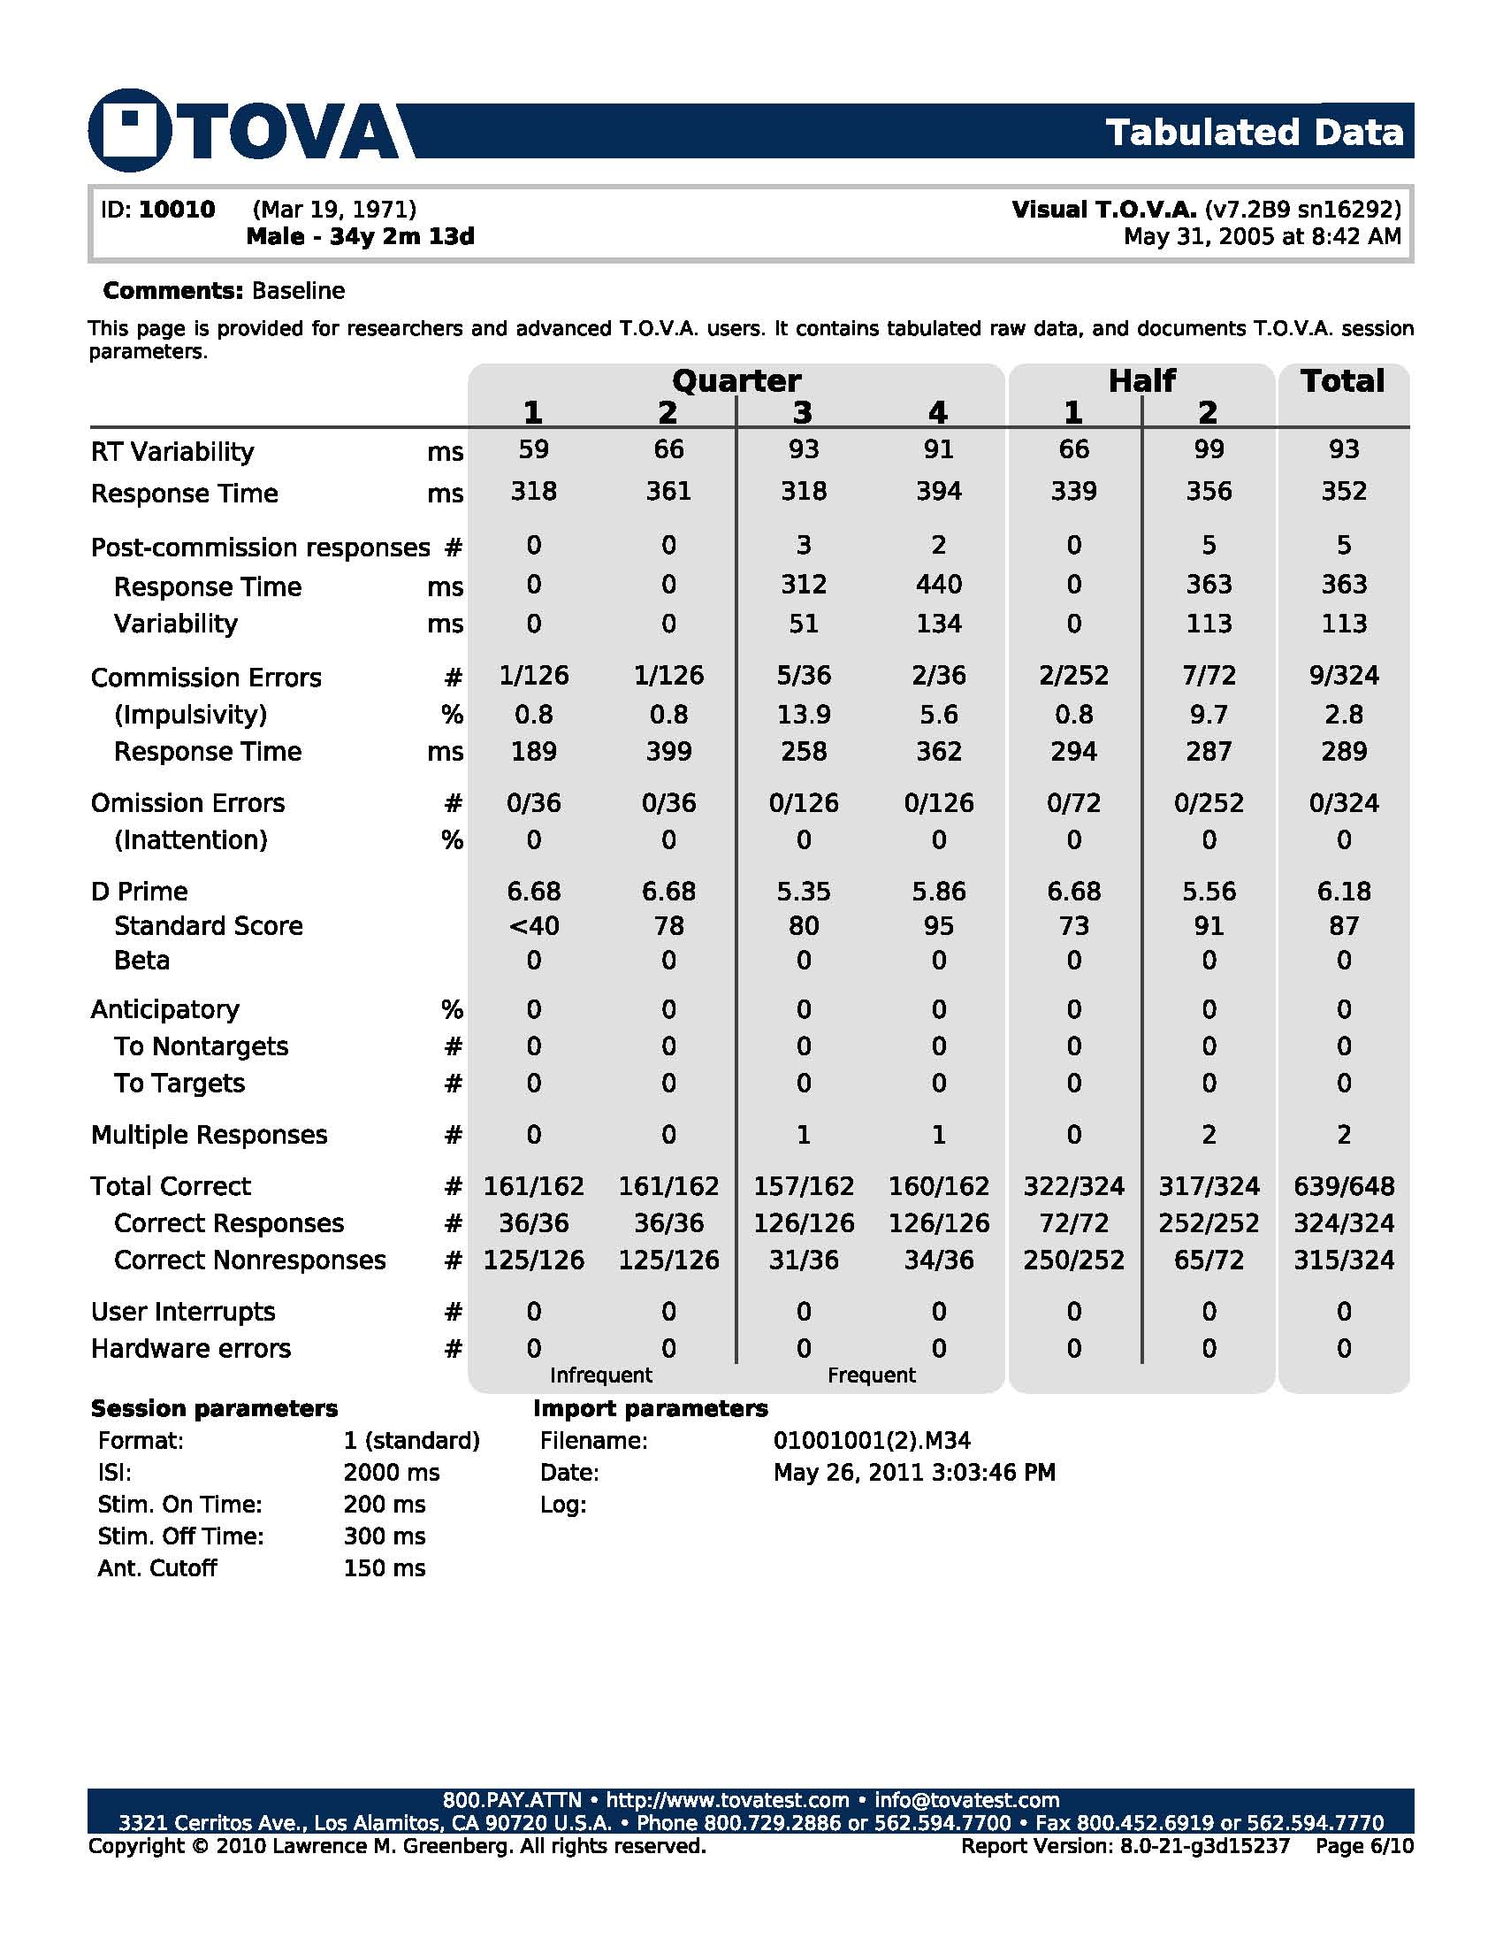

Slide 90
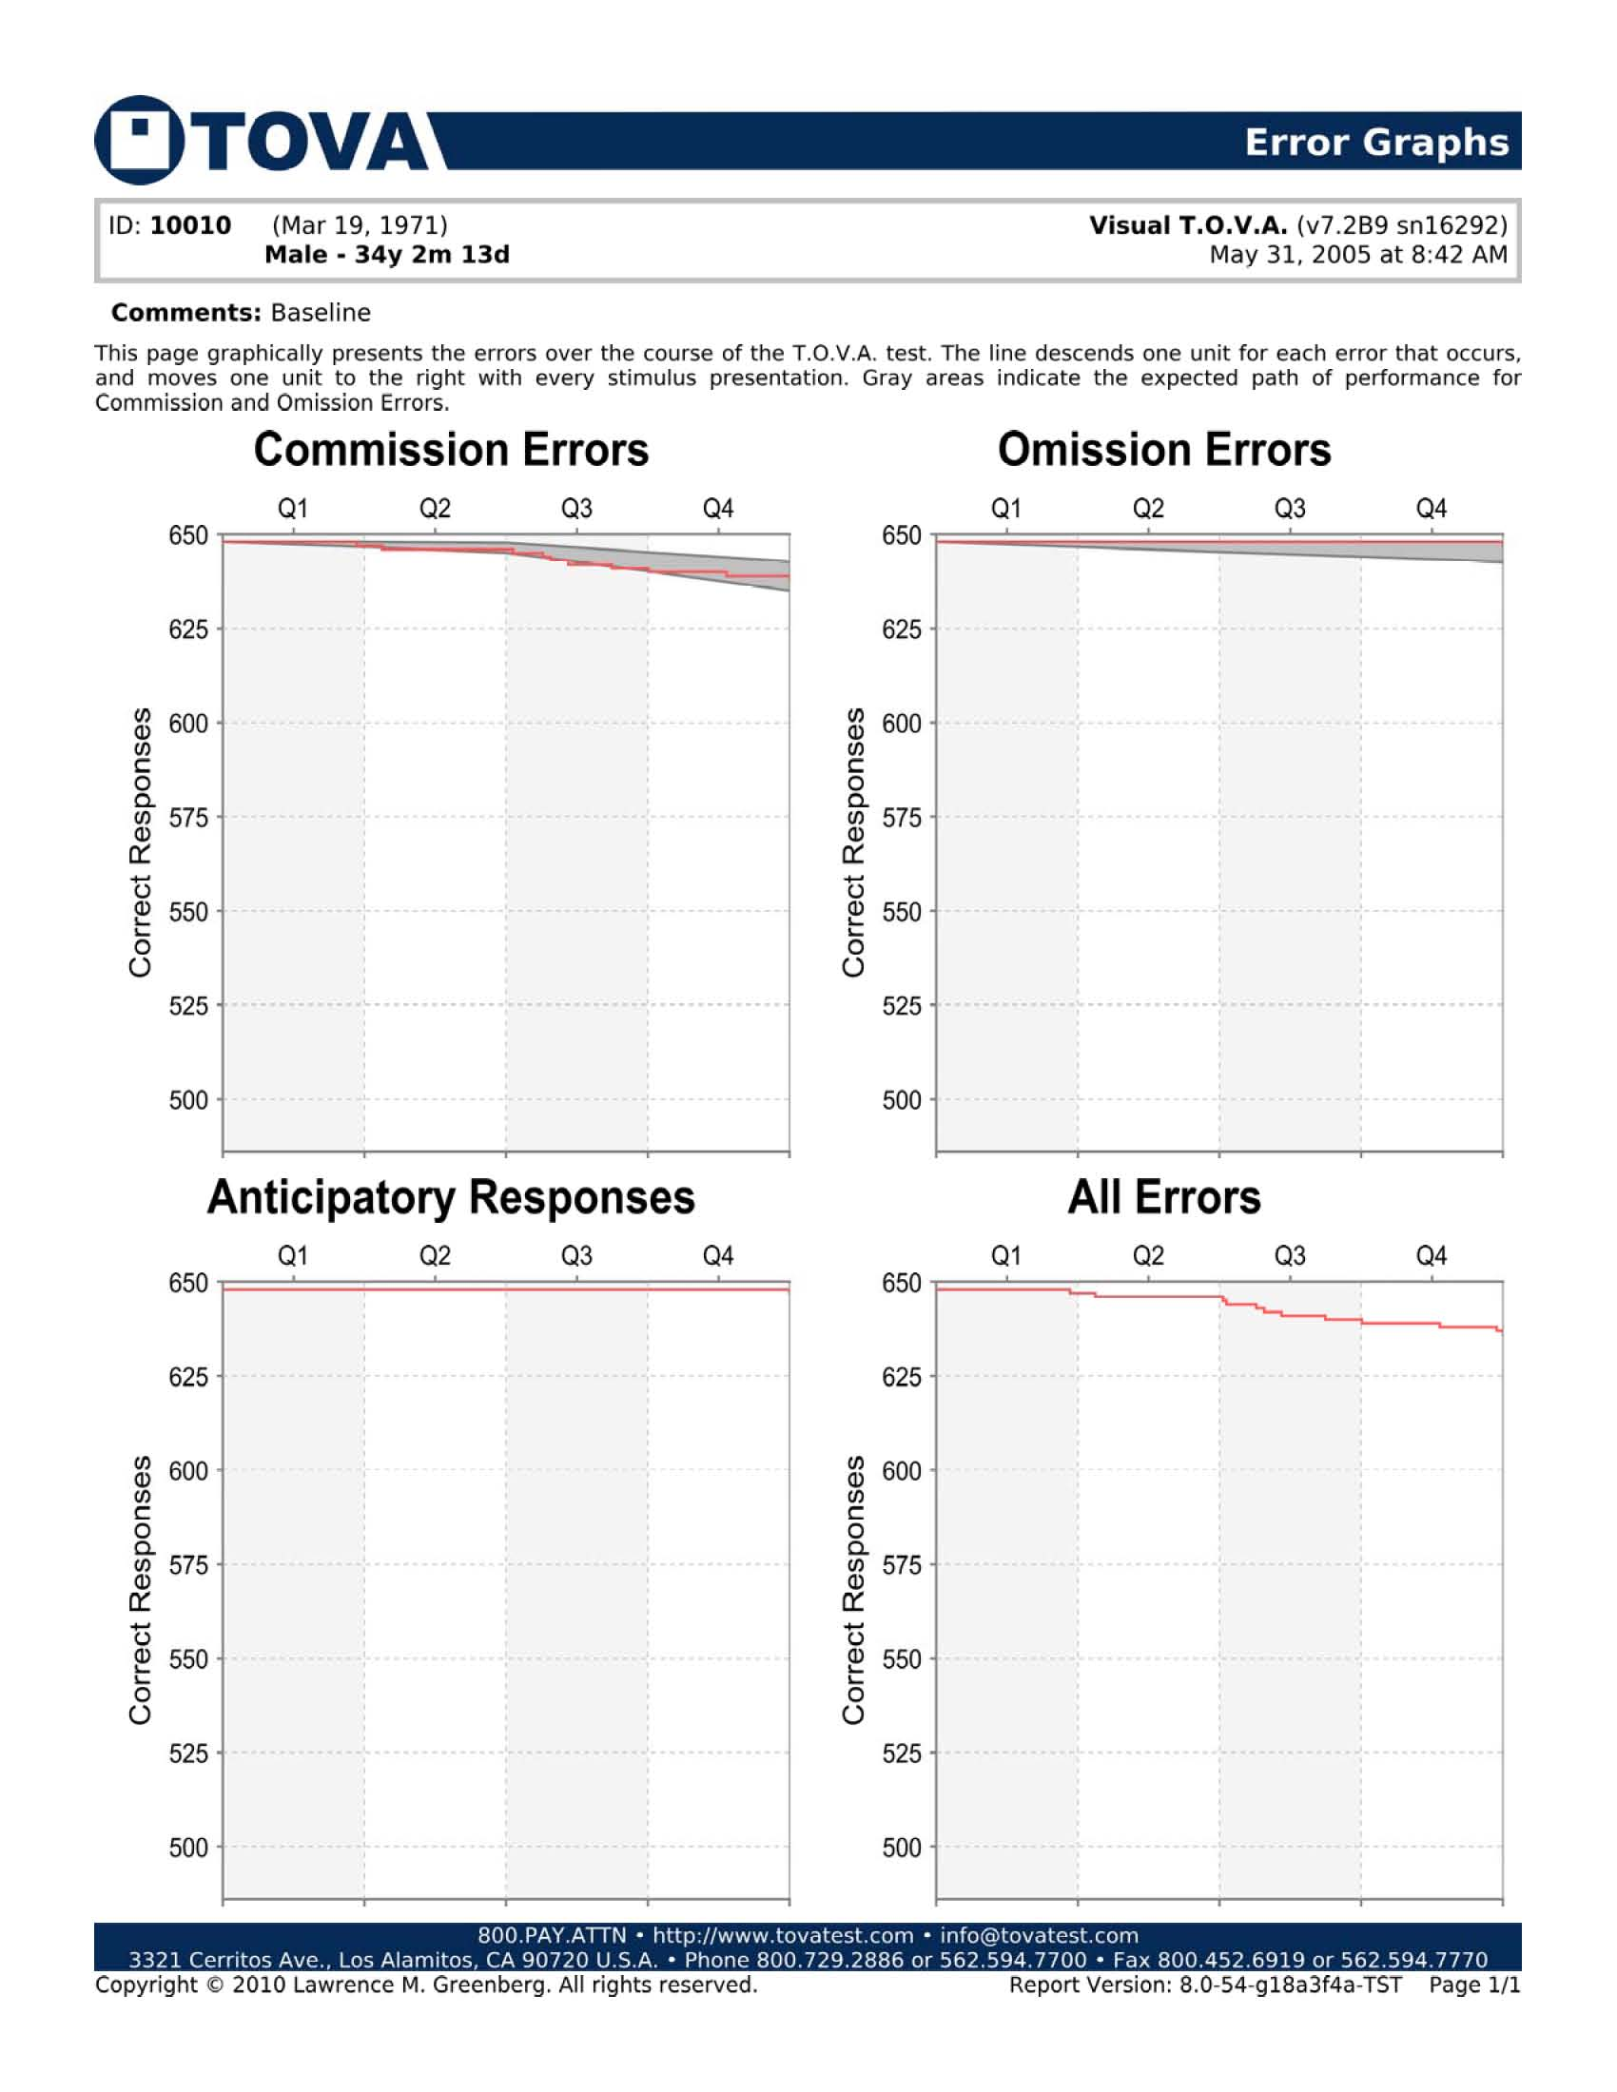

Slide 91
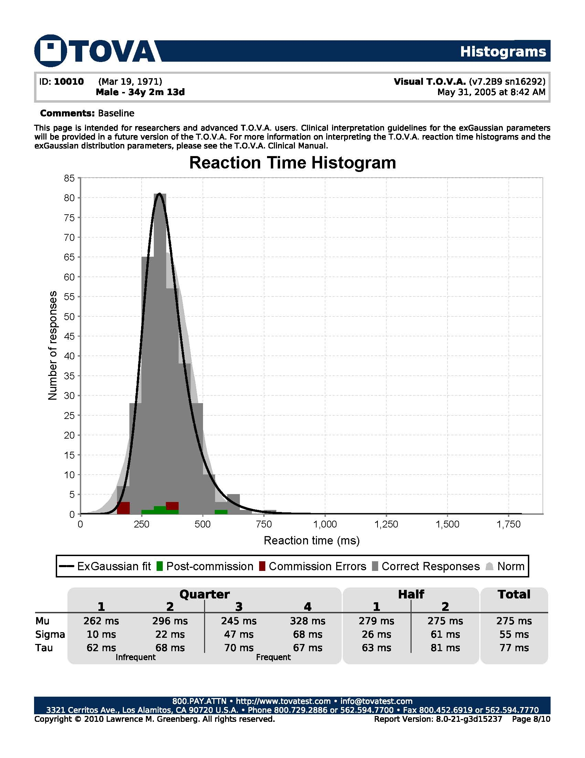

Slide 92
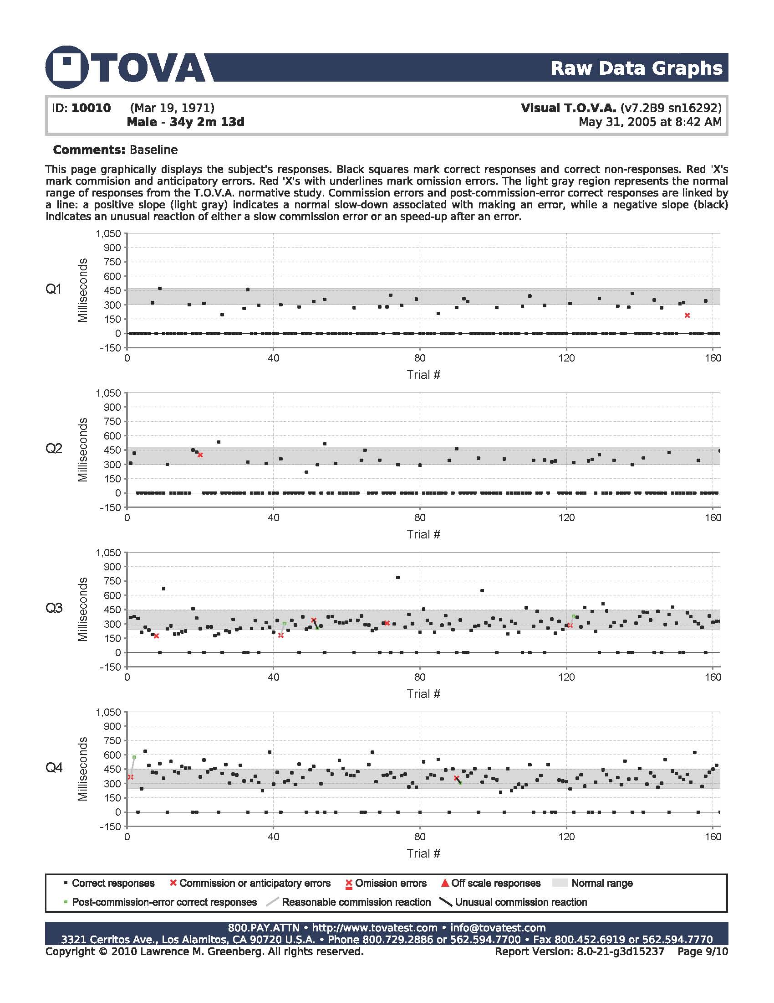

Slide 93
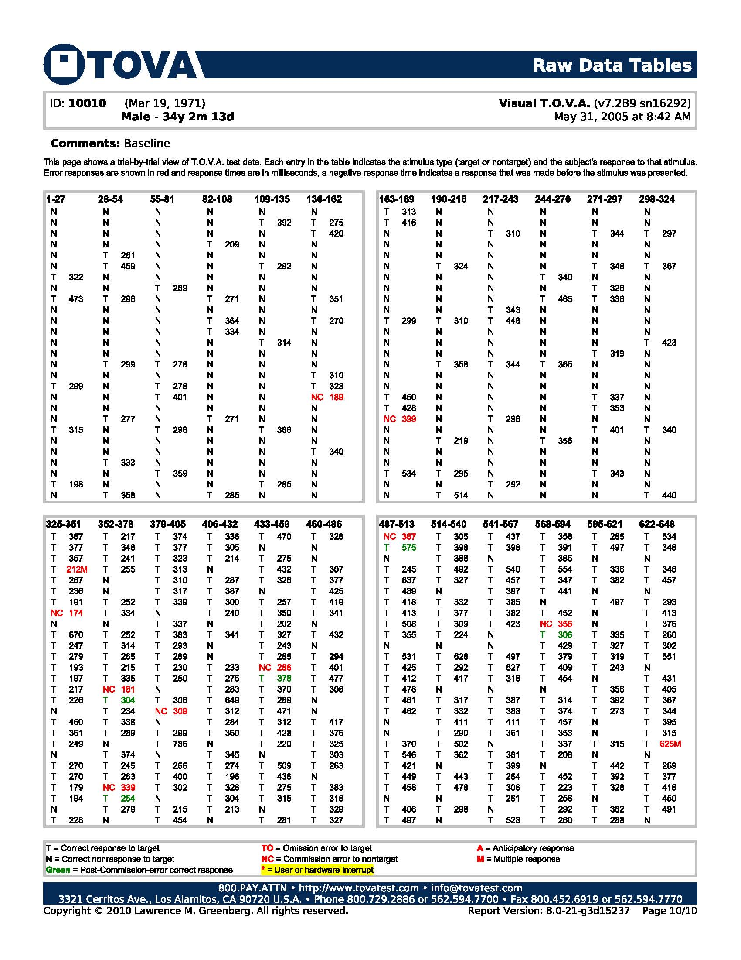

Slide 94
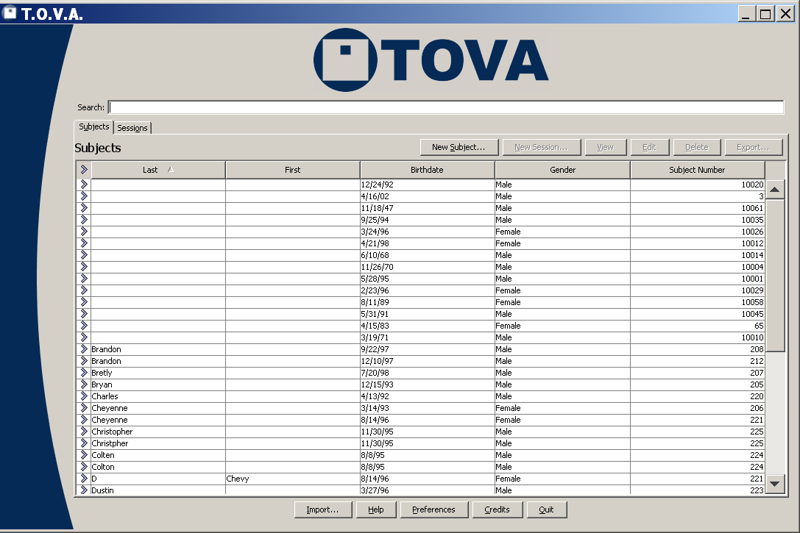

Slide 95
